Slide 1
Green Norse Tilgnerka
And the successful accommodation of other projects in our school

Slide 2
Our reasoning for joining this project
To adapt to the changes in our world's environment
To highlight the importance of environment-friendly and ecological education
School was previously successful with a project 'Blue Tilgnerka' (Modrá Tilgnerka)
“Working together for a green, competitive and inclusive Europe”

Slide 3
Table of Contents
Blue Tilgnerka
The Original Goals of Blue Tilgnerka
Implementation I
Implementation II
Implementation III
Implementation IV
Our Success
Green Norse Tilgnerka
Our Goals
Soft Measures
Spreading Awareness
Quality of water
Promote recycling
Hard Measures
Amount of greenery
Reduce garbage
Rainwater Storage
Reduction of asphalt roads
Event Organizing

Slide 4
"Blue Tilgnerka" is a previous project done by our school, which was financed by a grant from Iceland, Lichtenstein and Norway respectively.
The project was in motion from September 2014 and lasted a whole year, until September 2015
The goal of the project was to develop and promote a curricula focused on rainwater management and its connection to climate change for primary schools
Overall, the project was a huge success and resulted in many positive changes to the school and its environment
Blue
Tilgnerka

Slide 5
The original goals of Blue Tilgnerka
1. Develop and promote a curricula focused on rainwater management and its connection to climate change for primary schools
2. Propagation of the project
3. Organizing workshops, lectures and presentations to raise awareness of the project among the public
4. Implementation of technical options (e.g. construction of a vegetation roof, construction of a rain lake and more...)
https://tilgnerka.edupage.org/a/modra-tilgnerka?eqa=dGV4dD10ZXh0L3RleHQ3NiZzdWJwYWdlPTY%3D

Slide 6
Implementation I - Vegetation roof
Successful construction of a vegetation roof divided into two kinds of vegetation:
Extensive: thickness of the layer is something among 60 to 150 mm with relatively low operation and maintenance requirements. Inclusion of self-vegetating plants which spread themselves across the entire roof
Intensive: thickness of the layer ranges from 250 mm up to 1000 mm. 250 mm include small bushes and trees, 1000 mm include demanding undergrowth and trees
There are two types of the vegetation roof according to the hydro-isolation system: one-layered and two-layered vegetation
https://tilgnerka.edupage.org/a/modra-tilgnerka?eqa=dGV4dD10ZXh0L3RleHQ3NiZzdWJwYWdlPTc%3D

Slide 8
Implementation II – Rainfall lake
Implementation of shallow depressions which gather excess water from nearby parking lots, roofs and other terrains connected to impermeable surfaces
Special plants have been planted which aid the lakes in filtration and transpiration. The decrease of runoff gives more time for the ground to get saturated
Main benefits remain:
Decrease of runoff
Filtration of foreign substances
Helping the micro-climate
Create an aesthetically-pleasing environment
https://tilgnerka.edupage.org/a/modra-tilgnerka?eqa=dGV4dD10ZXh0L3RleHQ3NiZzdWJwYWdlPTg%3D

Slide 9
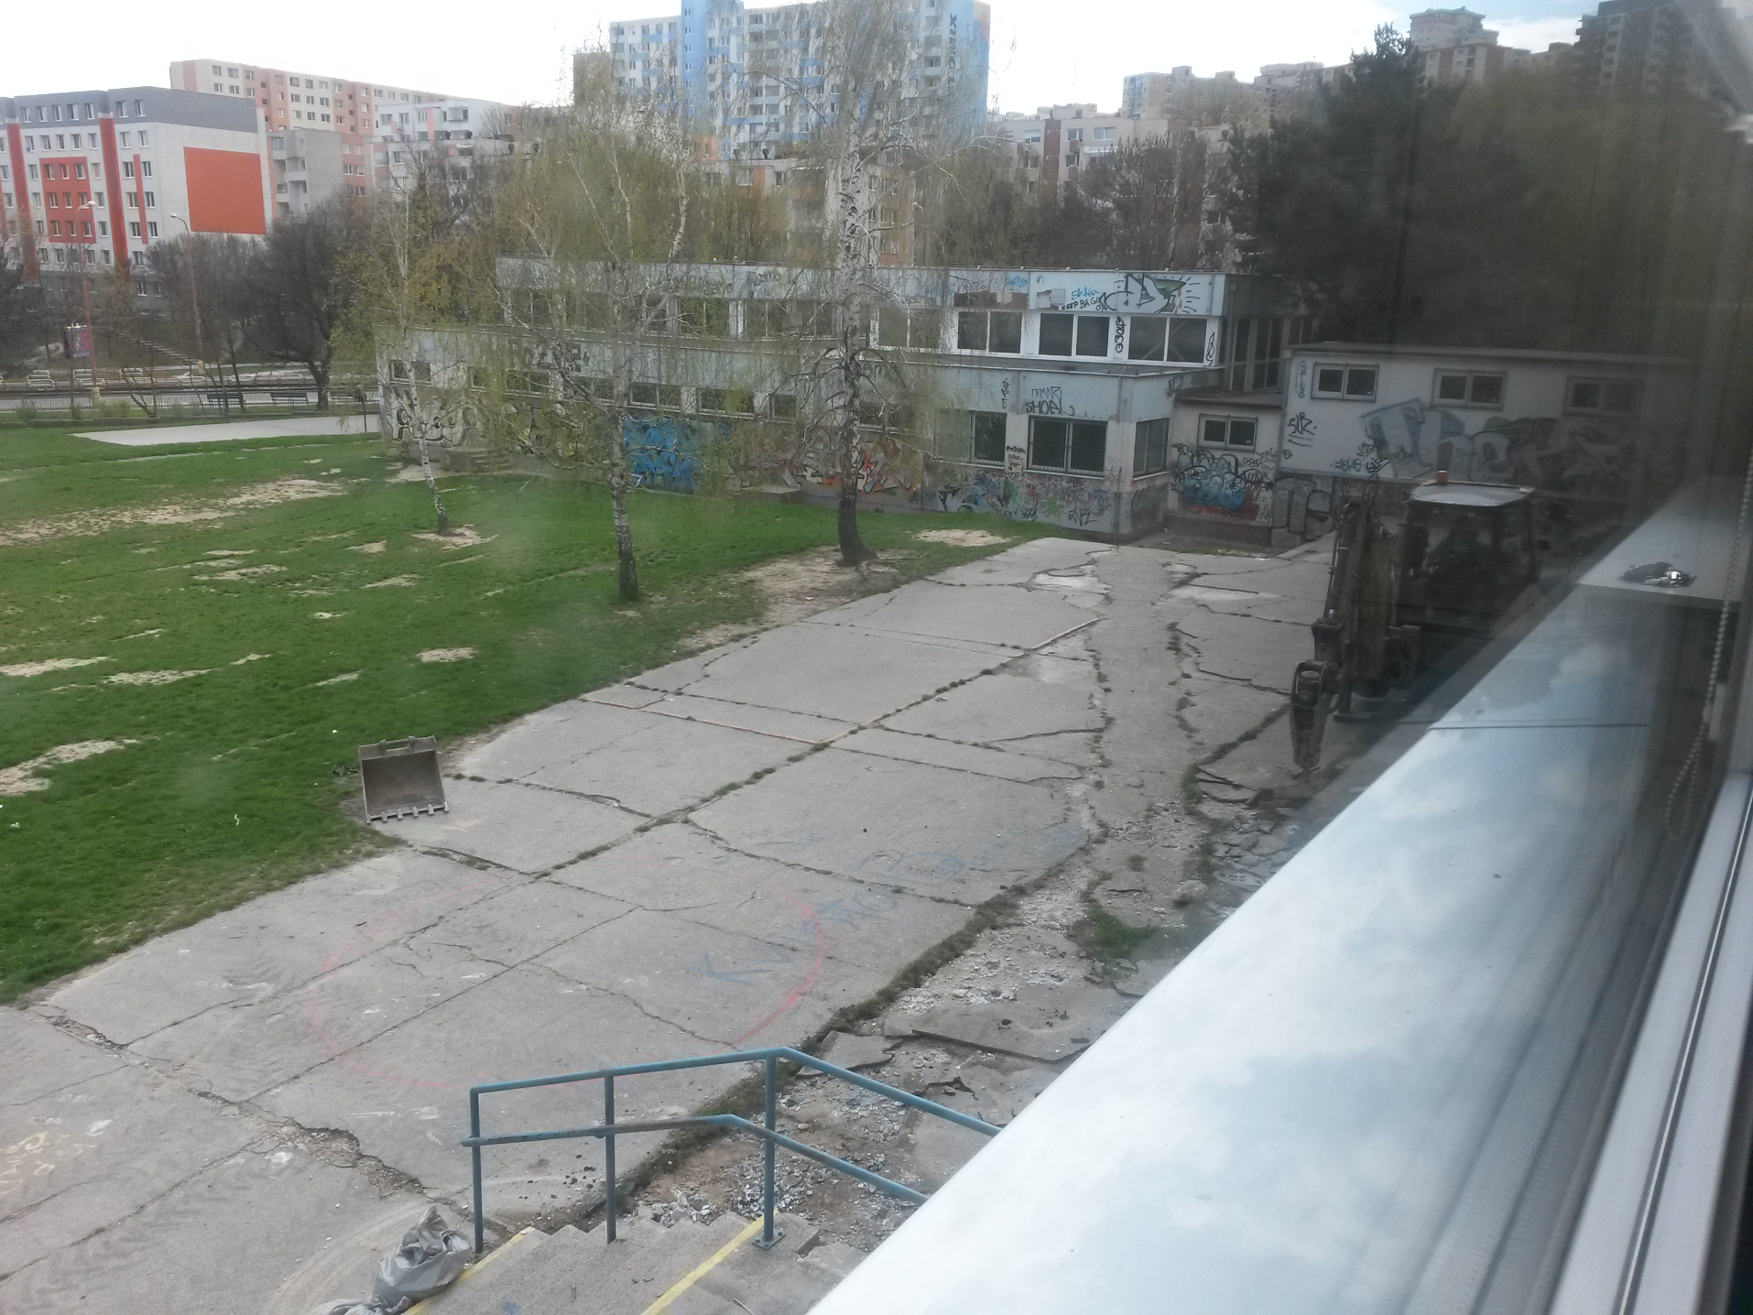
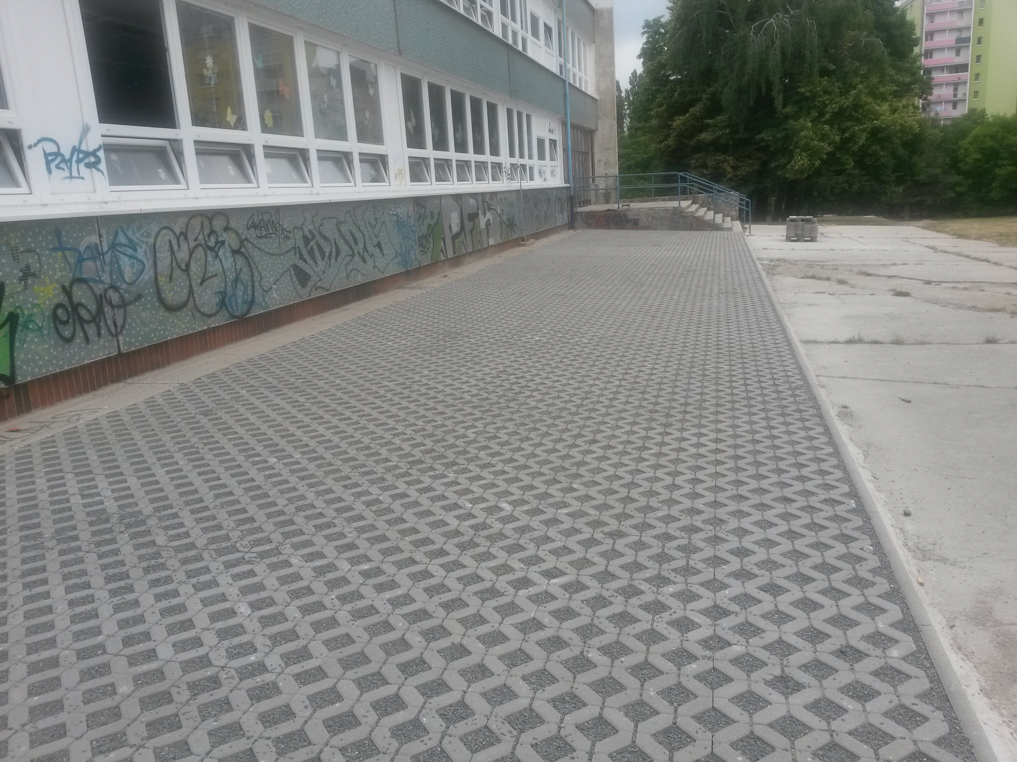
Implementation III
Before
Implementation of semi-vegetative segmenting blocks
The blocks gather water to better retain humidity for a more pleasant micro-climate
Exchanging the asphalt roads of the segmenting blocks prevents the chance of underflow, which would severely damage the area ( shown in the before picture )
Possibility of planting the vegetative plants from Implementation I to reduce local humidity
After

Slide 10
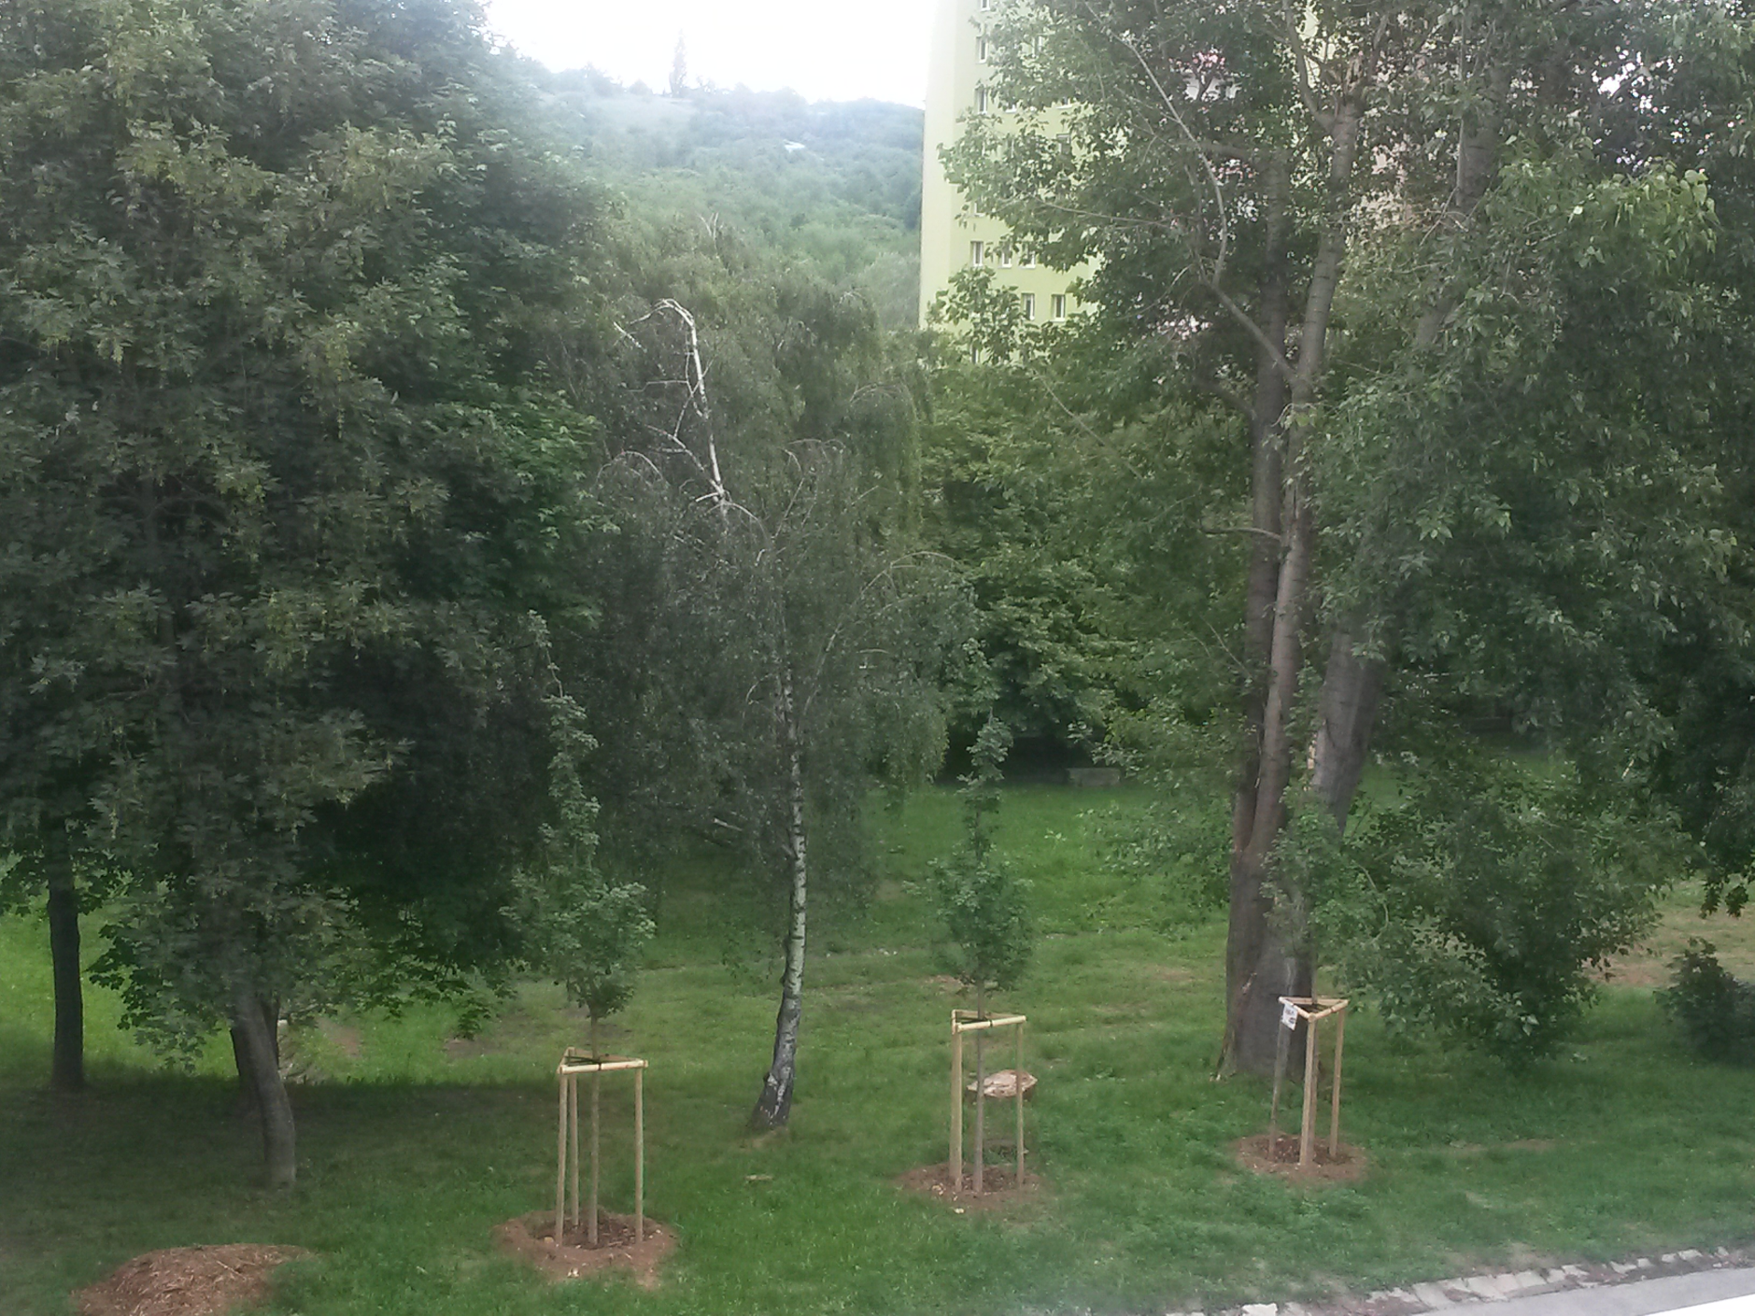
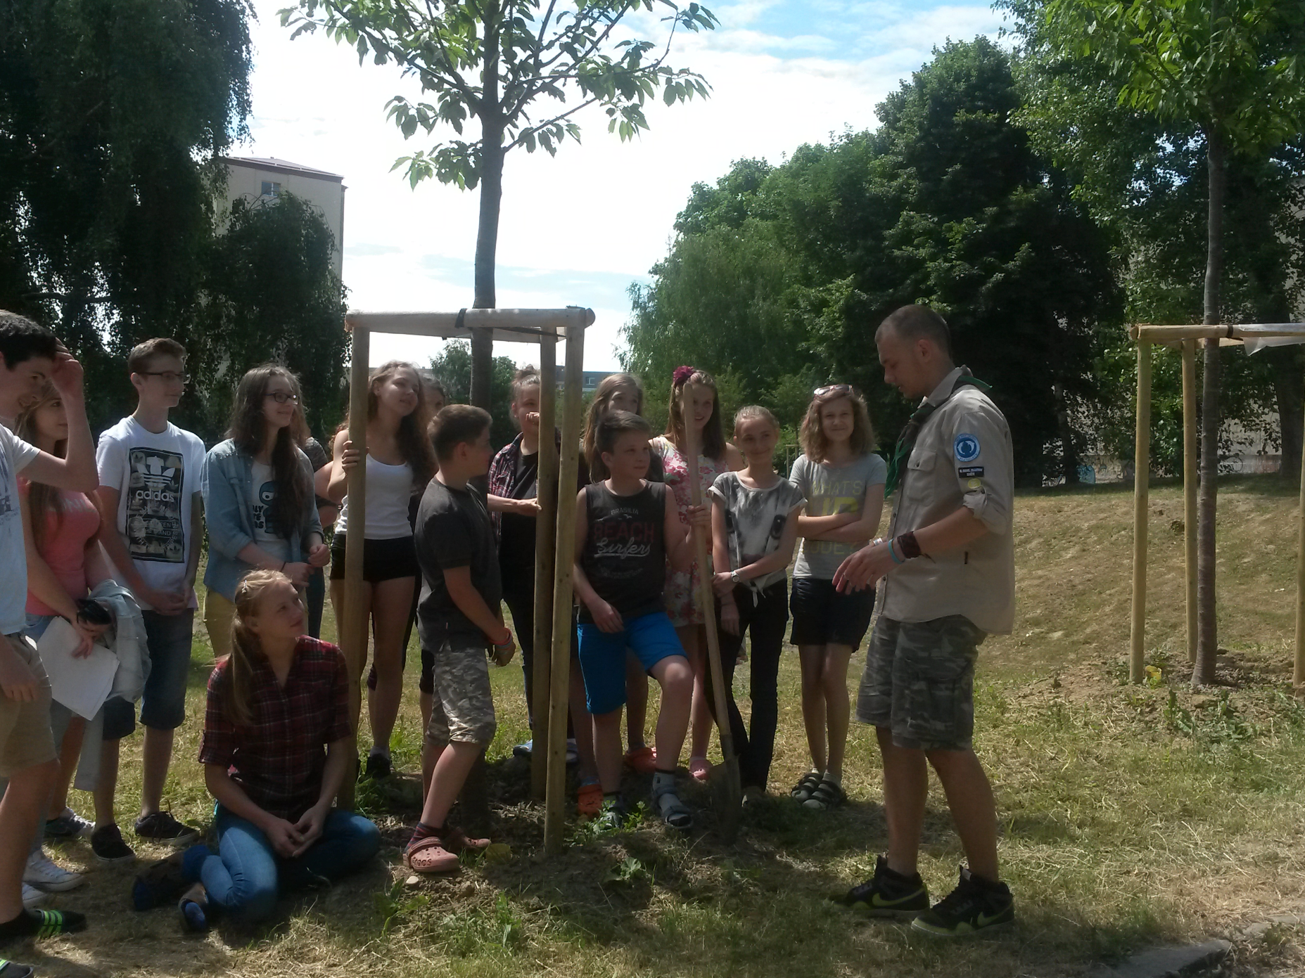
Implementation IV - Saplings
Collaboration between the students and local scouts which resulted in planting numerous tree saplings in the area.
The tree saplings offer a better micro-climate, more aesthetically pleasing space, less gas emissions as well as forge bonds with local communities interested in contribution to a better environment
Part of the implementation was to educate the students about nature preservation as well as the effect of more greens in the area

Slide 11
A success!
https://tilgnerka.edupage.org/a/modra-tilgnerka?eqa=dGV4dD10ZXh0L3RleHQ3NiZzdWJwYWdlPTE5
One of our teachers, who is an environmentalist wrote articles about our project​
Our project was shared and published on other sites as well, spreading awareness as was our goal
It made its appearance on countless other media as well as the "Blue schools" festival

Slide 12
Green Norse Tilgnerka
Soft Measures
Hard Measures

Slide 13
Our goals
Our main goal is to spread awareness about climate change and combat it effectively through efficient solutions
We desire to buy learning materials to point out the importance of educating about the climate change with our students
We would also discuss micro-climate, environment and plant management and rainwater storage and usage

Slide 14
Spreading Awareness
We desire to create and hand out leaflets to spread awareness about climate change and recycling as well as all the other topics mentioned before in our presentation
Educate all our students about the issue and its resolution through a proper way
Have a "Green Tilgnerka day" which would be a sort of festival (similar to Blue Schools festival) focused around the promotion of environmental preservation
Host seminars focused on spreading awareness about the said issue

Slide 15
Quality of Water
CDOM / FDOM monitoring:
Coloured dissolved organic matter occurs naturally in water bodies, it absorbs UV light and turns the water murky. Electrical optical sensors would monitor and prevent the issue
Recording water's temperature
Digital temperature sensors would provide in depth analysis of the water body
KH and pH testing
Color-coded water test kits
Conductivity, Salinity and TDS monitoring
Measured by electrical conductance or released electrolytes

Slide 16
Promoting Recycling
We want to educate our students as well as the general public on the importance of recycling by hosting workshops, lectures and presentations
We want to place recycling bins in every class so that every student can separate their trash in order for it to be recycled
We desire to implement more separation containers in order to recycle greater amounts of trash and pursue all of our students to recycle

Slide 17
Increase the amount of greenery
Plant more plants and greenery on school grounds
We plan to buy new fruit tree saplings
New vegetation roof – A reconstruction of the school building roof into a garden that manages micro-climate
Decreases temperature in the building in summer
Increases temperature in the building in winter
Contributes to oxygen production
Not flammable
Protects the roof from extreme weather

Slide 18
Reduce garbage
We wabt to continue our reduction of garbage by buying more seperation containers
The said containers would be for glass, plastic, paper and even glass for certain instances
Students would gather the garbage throught the entire week and every friday, the trash would be taken out to the respective conttainers
Students would be constatnly reminded and educated about seperating garbage and also informed about the consequences if they do not follow the system

Slide 19
Rainwater storage
We want to build a fountain on our school grounds, accompanied by vegetating plants placed around it
This construction would contribute to the aesthetic side of the school environment
The fountain would run purely on gathered rainwater and he vegetating plants would also benefit water management
A needed inclusion would be a container to store rainwater which would be hidden underground

Slide 20
Reduction of asphalt roads
We would like to continue the reduction of asphalt roads and replace them with semi-vegetative segmenting blocks, which would result in greater heat absorbtion, more space for saplings and an overall micro-climate positive environment
Due to the success of our previous project, we would like to expand it even more
Furthermore, as mentioned earlier, the blocks retrain humidity and create a better micro-climate
Prevention from underflow is also expanded

Slide 21
Event Organizing
We want to create publicising events which would spread awareness about environmental issues as well as pursue other schools and civic assosiations to contribute to our society by holding similar projects
Workshops for younger students would be held for educational and informational purposes
Older students could participate in creating these events, since we have many eager environmentalists

Slide 22
Undoubtful success
With the generous help from Norway grants, we will surely:
Create a better and more prosperous environment for our students
Educate our students about environmental issues
Spread awareness further into the community
Since the previous project was a huge success, we have no doubts that this one will follow in its footsteps
We are always happy to collaborate with other countries and make our envirnoment a better place for future generations

Slide 23
Thank you for your attention
Presentation was created by: Oleg Olegovič Knyazev, Sonia Štefunková, Simona Tichá, Michal Polakovič and Vilma Peciarová

