Slide 1
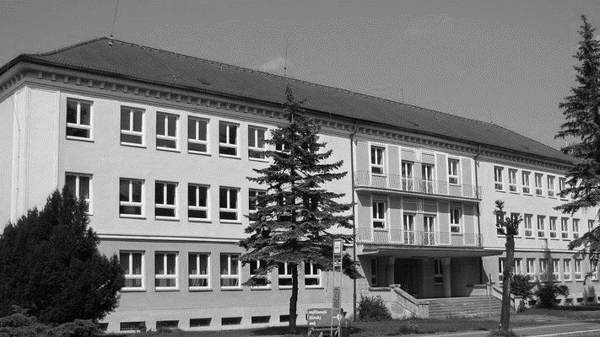
Our school
Badárová, Mihalčatinová,
Šustek, Bodlala

Slide 2
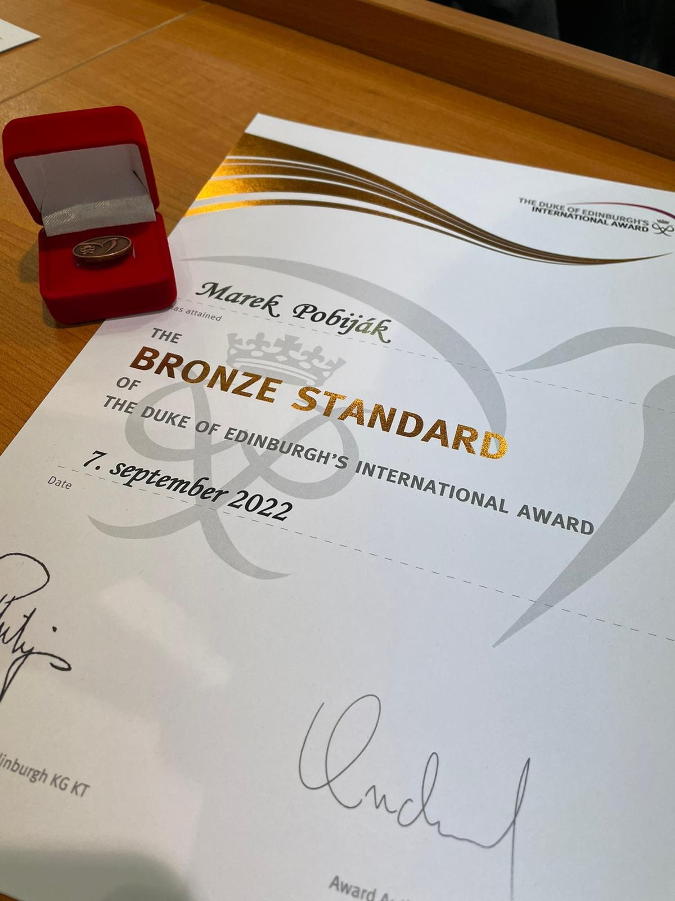
Duke of Edinburgh
a program with 60 year old tradicion
the aim is developing skills and lifestyle
you'll receive bronze,silver and golden
awards over time
by becoming a Duke you receive an
International certificate

Slide 3
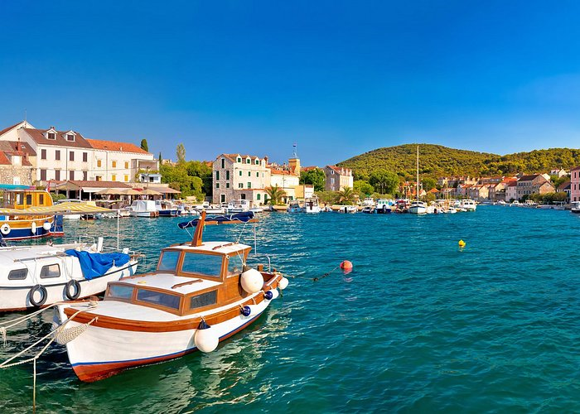
Swimming course in Croatia
every year in september students in the second grade can visit Croatia for a week
on their stay they swim in the sea, go hiking and explore the Croatian cities
It is a great way to explore the world with your friends

Slide 4
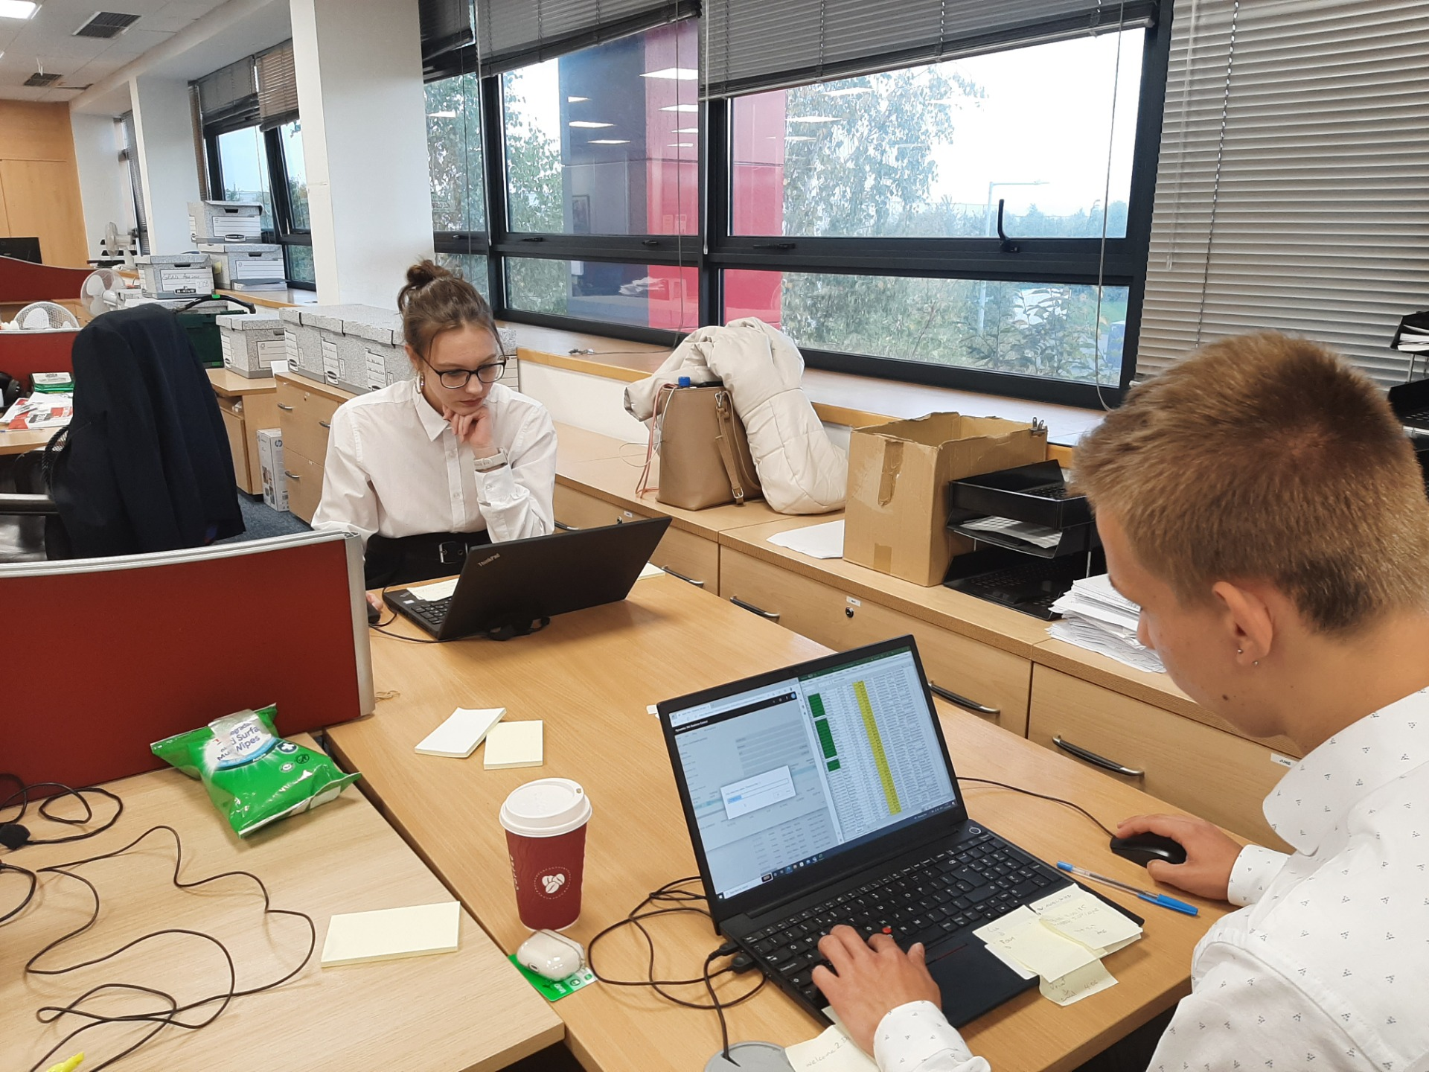
using learned knowledge of english language
earning new professional and practical experiences
discovering new cultures, work life and life abroad
exploring interesting parts of Dublin
Bussines practise in Dublin

Slide 5
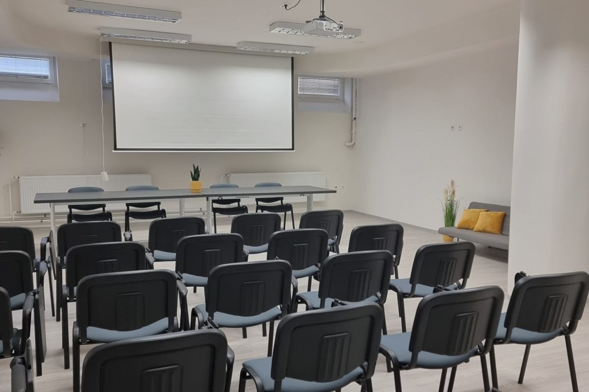
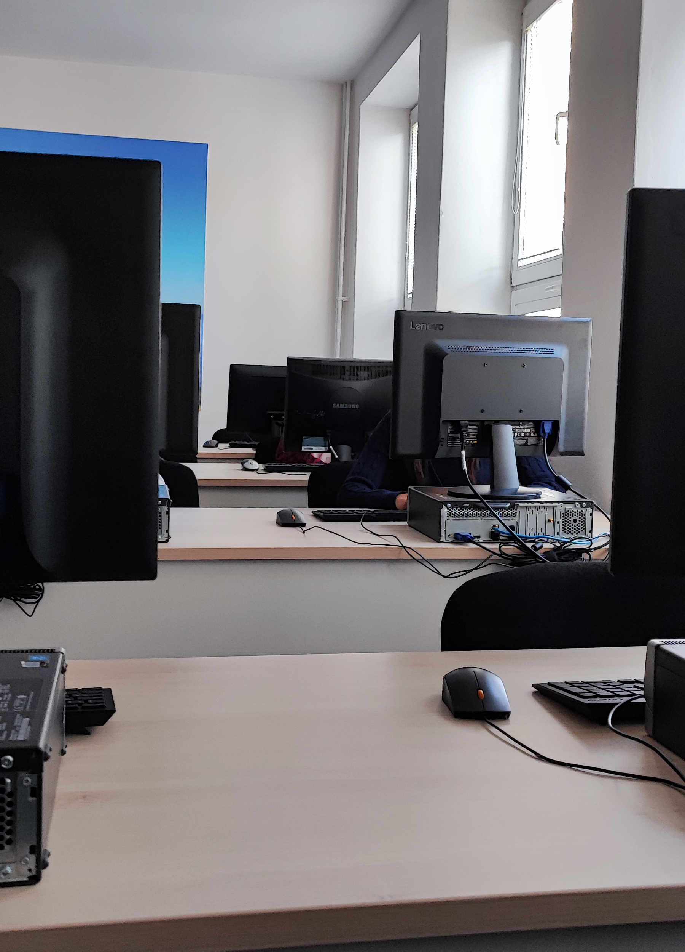
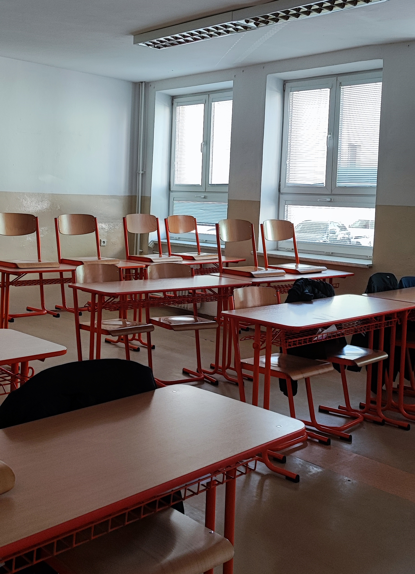
Our classroom

Slide 6
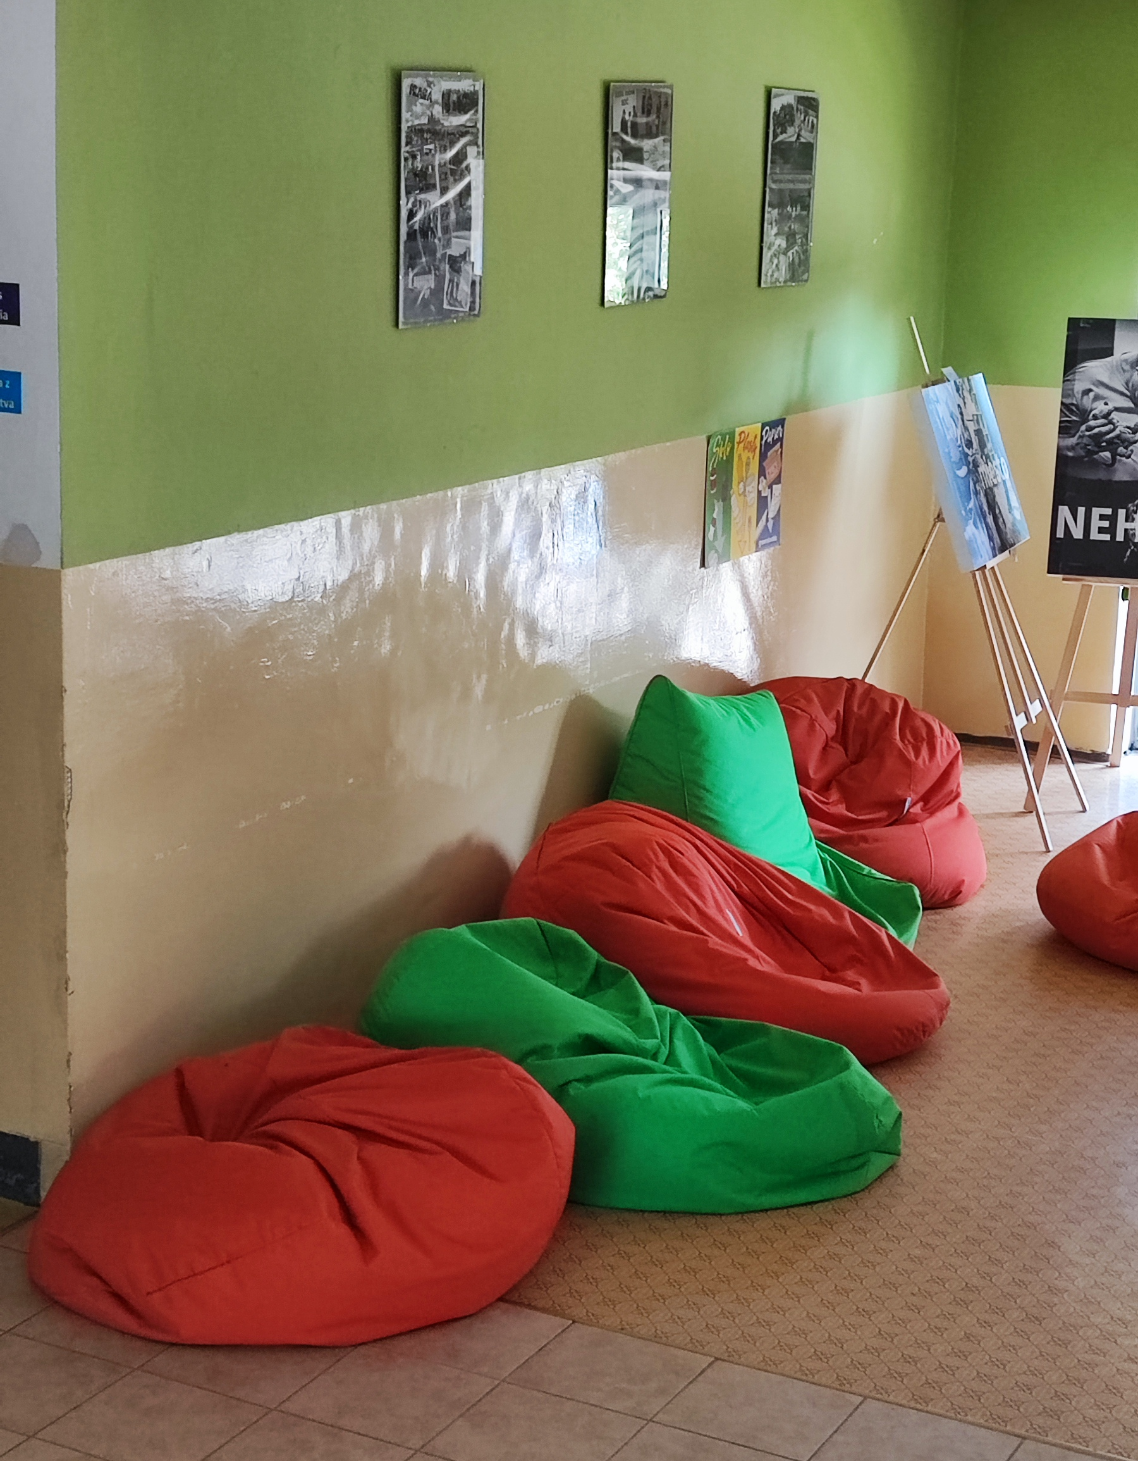
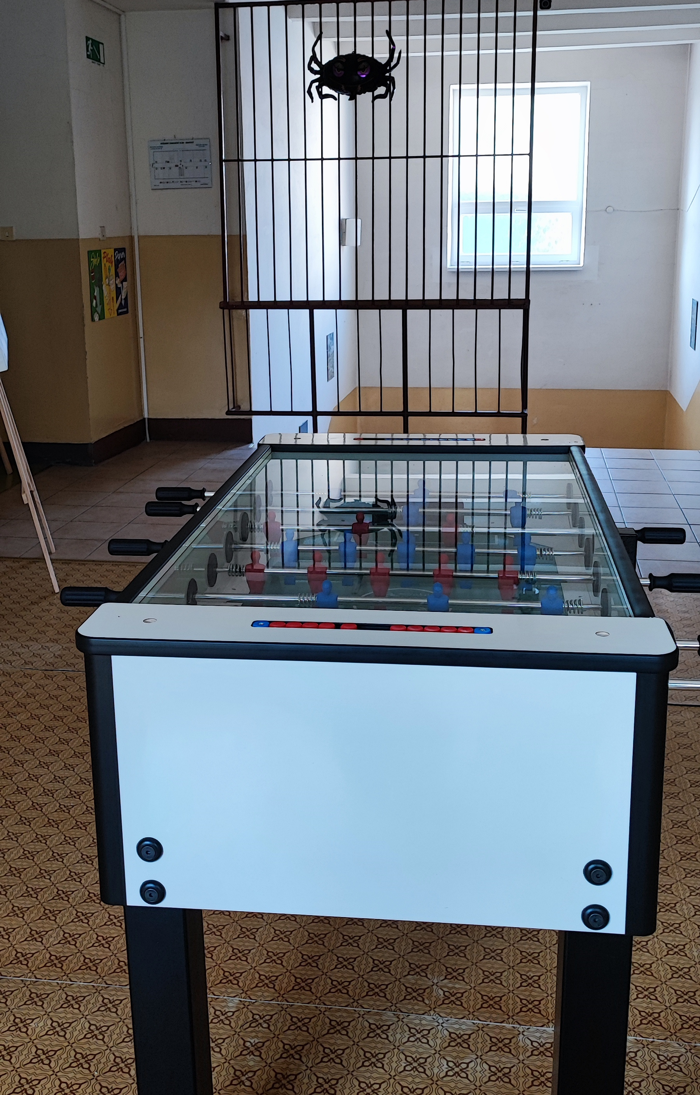
Relax zone
on our school we have relax zones where students can go during breaks
outside there are ping-pong , swing and also there is smooking zone just 18+
inside there are foosball, beanbag, benches

Slide 7
Thank you for paying attention

