Slide 1
Republic of Croatia
Republika Hrvatska

Slide 2
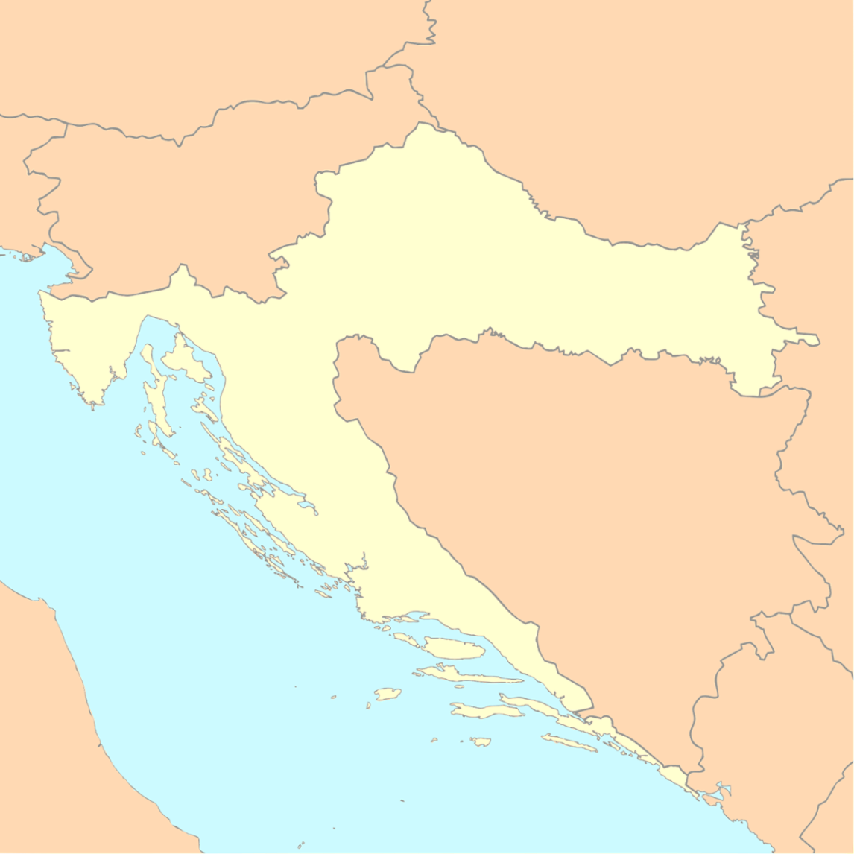
Where are we?
Hungary
Croatia is a medium size European country
Country position is Central European and Mediterranean, as well as Pannonian Adriatic
The 45th parallel of the northern latitude runs through Croatia
Slovenia
Varaždin
ZAGREB
Sisak
Osijek
Serbia
Pula
Rijeka
Bosnia and Herzegovina
Zadar
Split
Montenegro
Dubrovnik

Slide 3
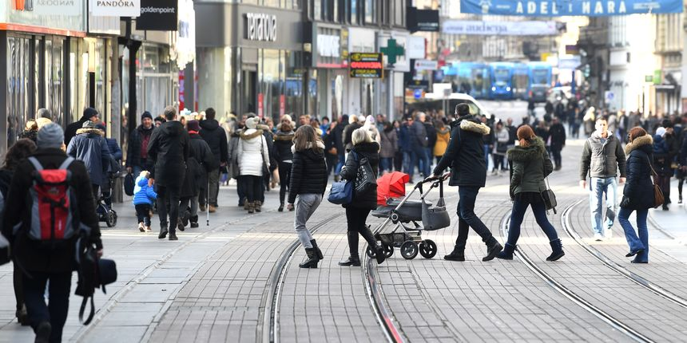
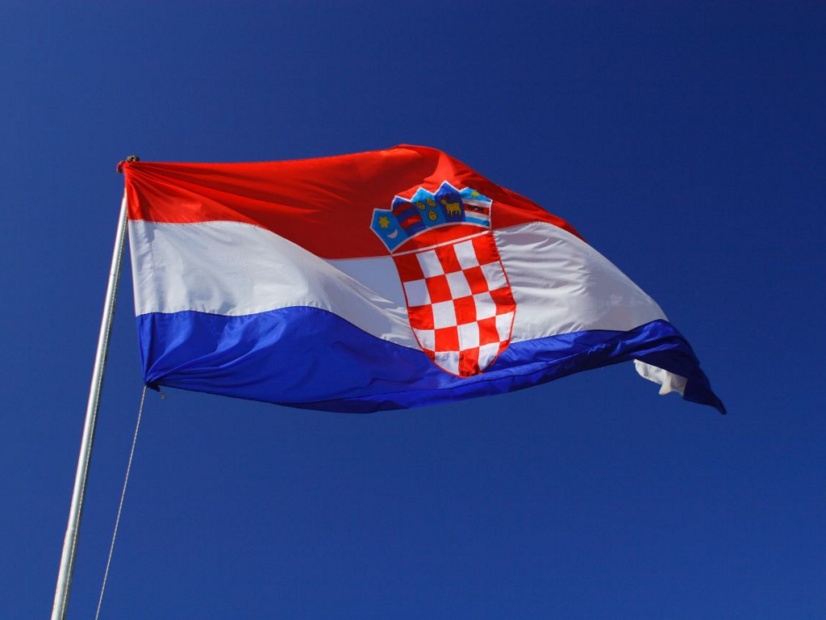
People - Croatians
population:
4,480,043 (July 2012 est.)
Croat 89.6%, Serb 4.5%, other 5.9%
life expectancy:
75.99 years (82nd in world)
Currency:
Croatian kuna
Ilica, main street of the capital city, Zagreb
Croatian national flag
official language:
Croatian
English is commonly used since

Slide 4
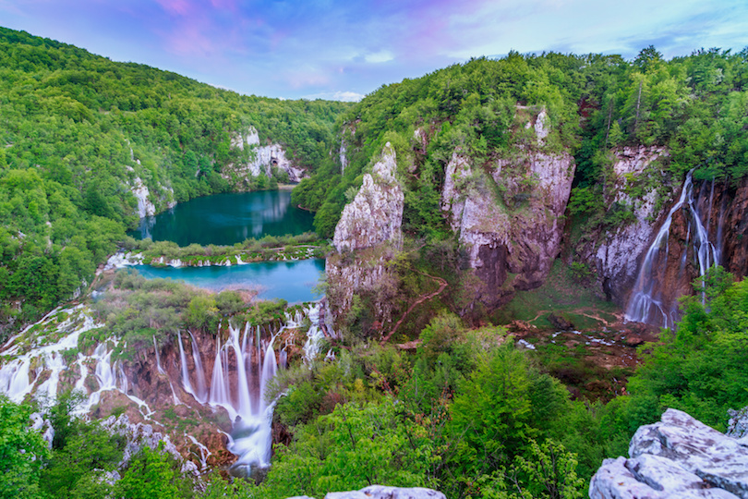
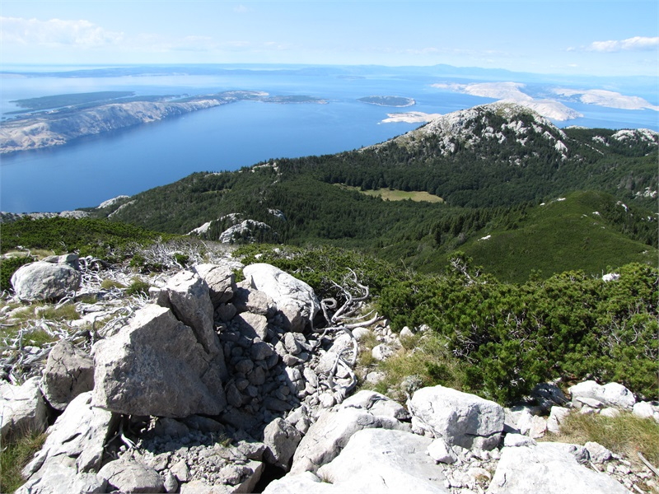
Natural heritage
Croatia has 8 national parks, 11 nature parks, 80 special reserves, sandy and rocky beaches and Mediterranean terrain
1 185 islands and rocks of which approximately 50 are inhabited
National park Plitvice lakes and ancient beech forests of Northern Velebit and Paklenica are on the UNESCO World Heritage

Slide 5
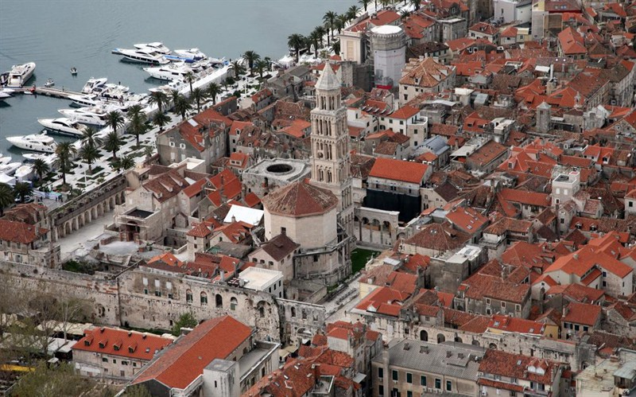
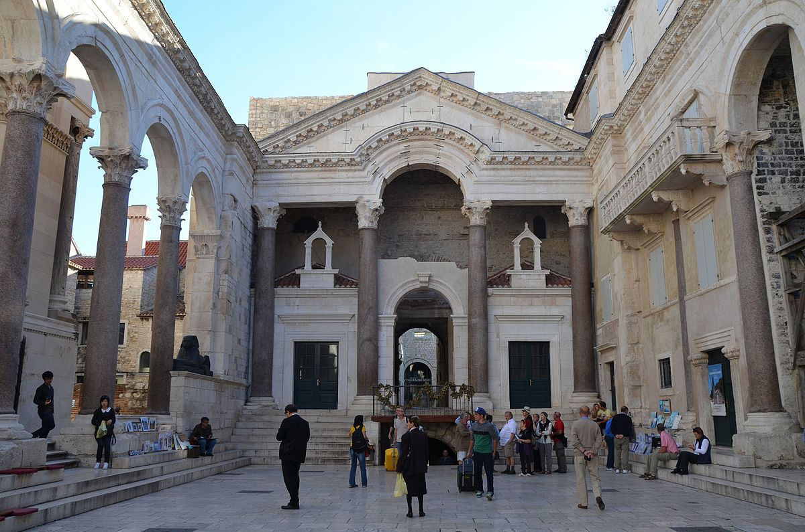
Cultural heritage - UNESCO World Heritage list
Historical Complex of Split with the Palace of Diocletian

Slide 6
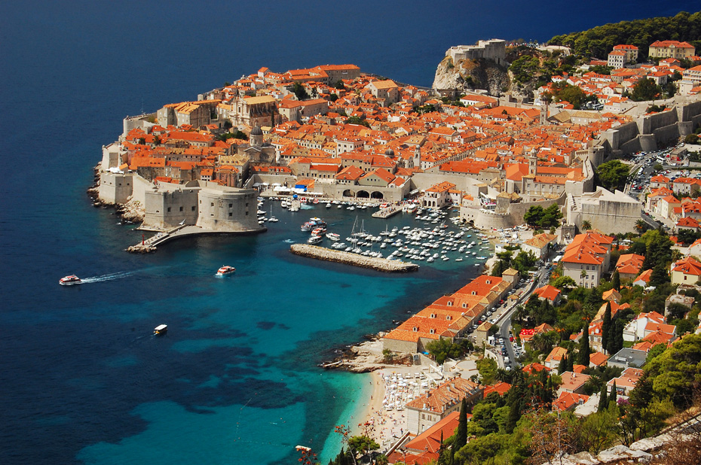
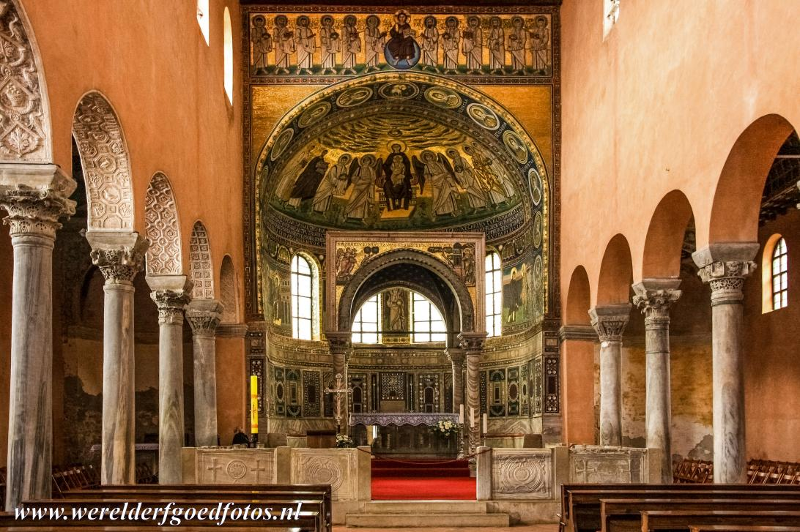
Cultural heritage - UNESCO World Heritage list
Old City of Dubrovnik
Episcopal Complex of the Euphrasian Basilica in the Historic Centre of Poreč

Slide 7
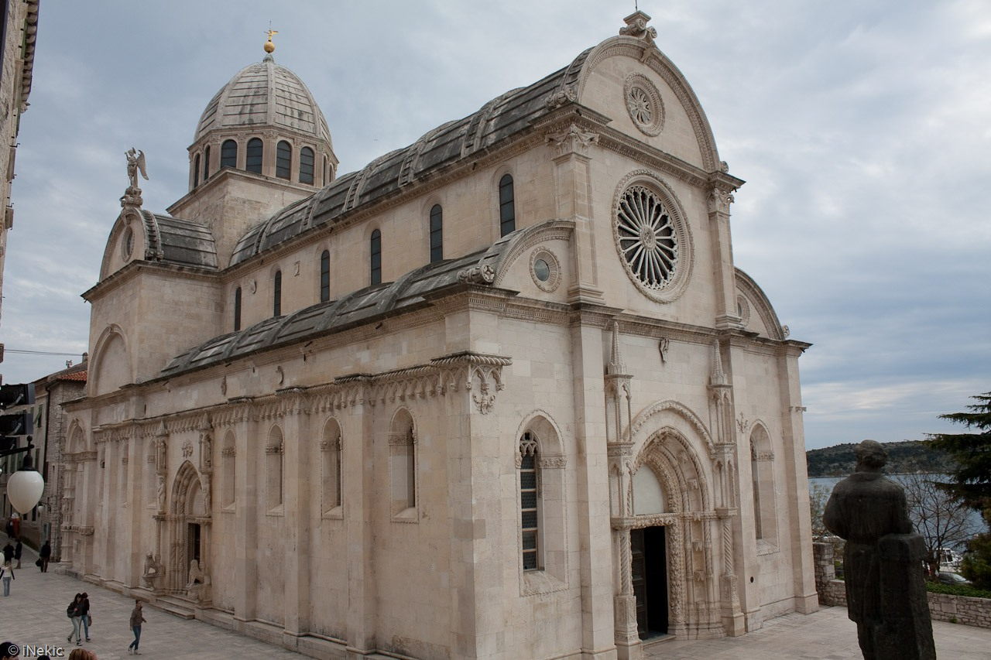
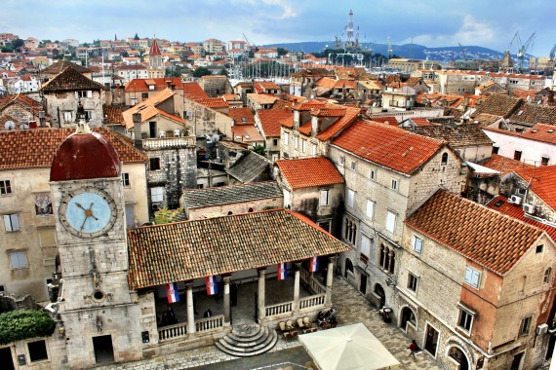
Cultural heritage - UNESCO World Heritage list
The Cathedral of St James(Jakov) in Šibenik
Historic City of Trogir

Slide 8
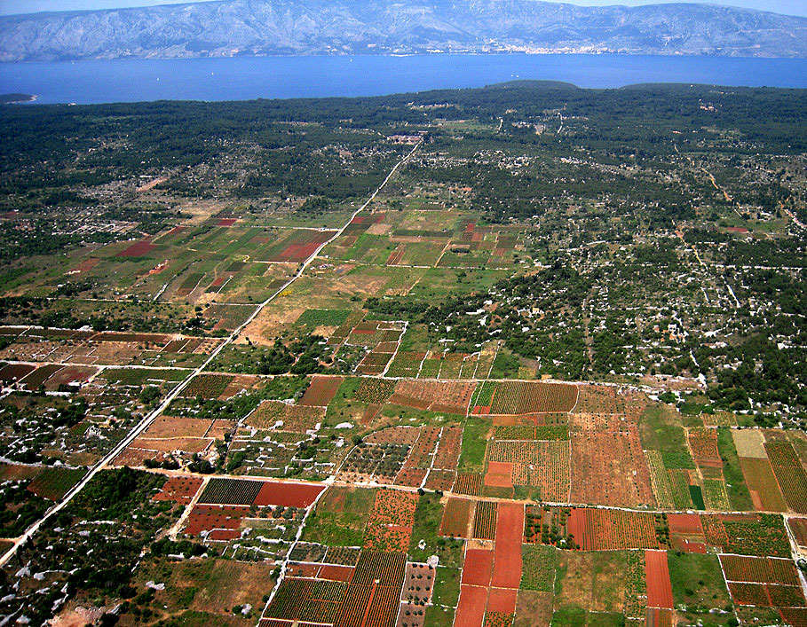
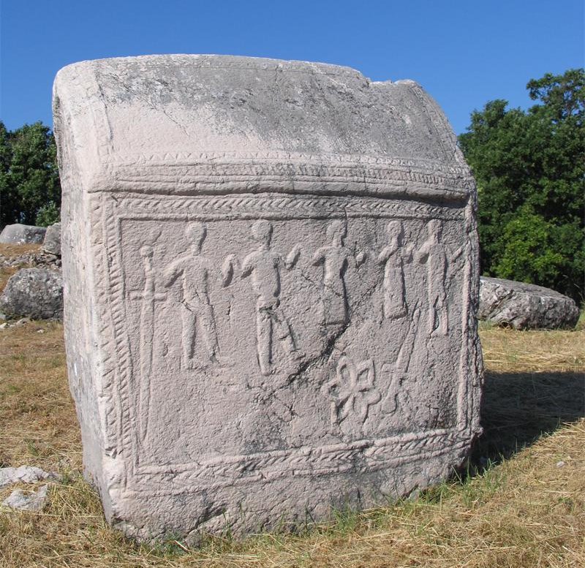
Cultural heritage - UNESCO World Heritage list
Starogradsko polje on the island of Hvar
Stećci - Medieval Tombstone Graveyards

Slide 9
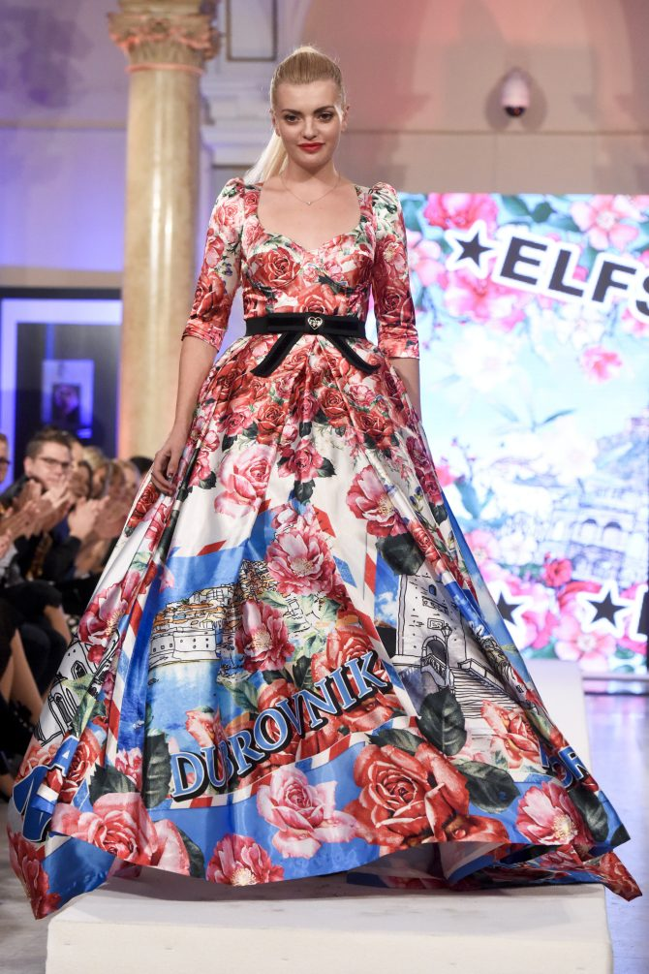
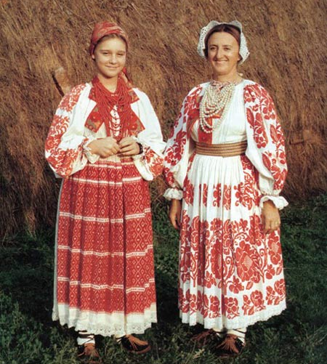
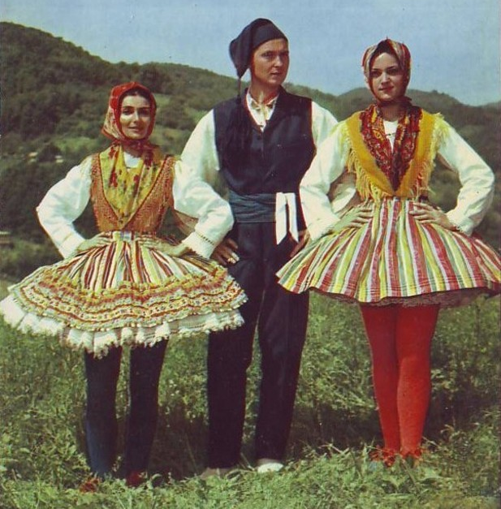
Fashion
the traditional clothes are different in every region (Slavonija, Dalmacija, Zagorje, Istra)
clothing styles
Croats have adopted western style dress today

Slide 10
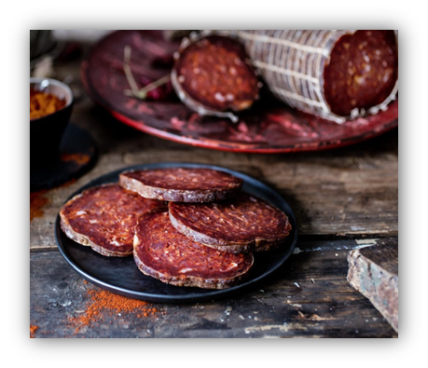
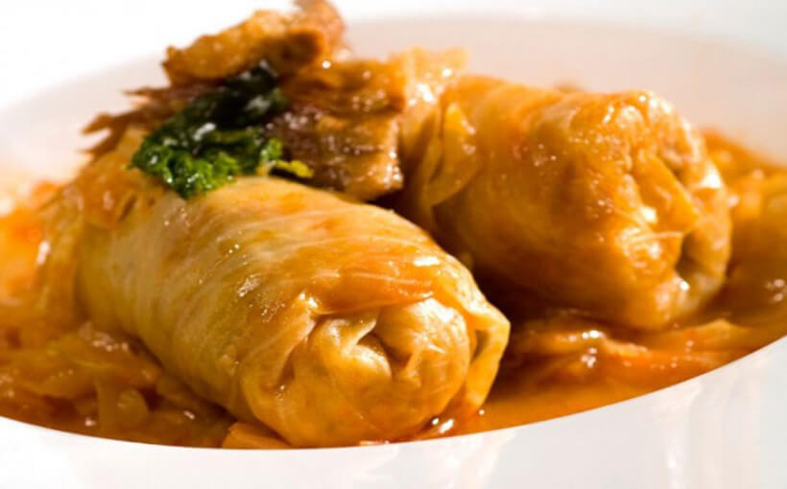
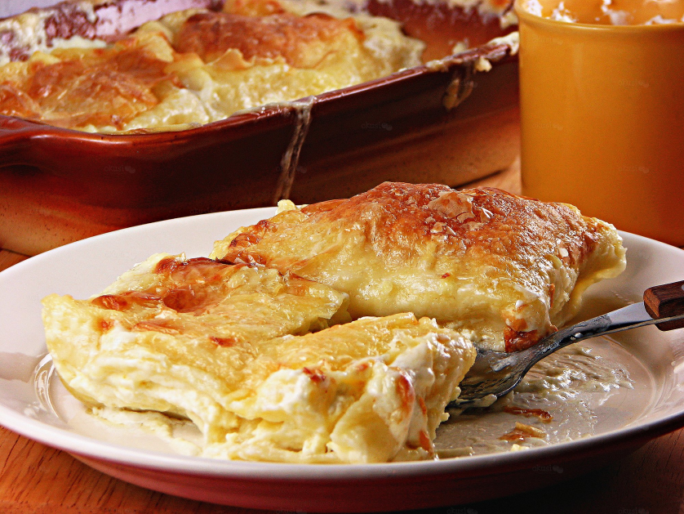
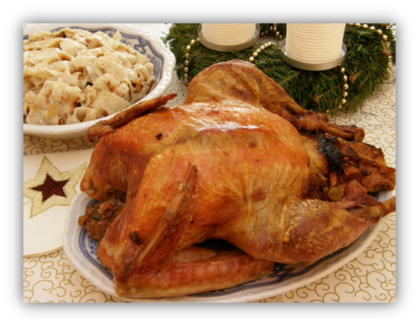
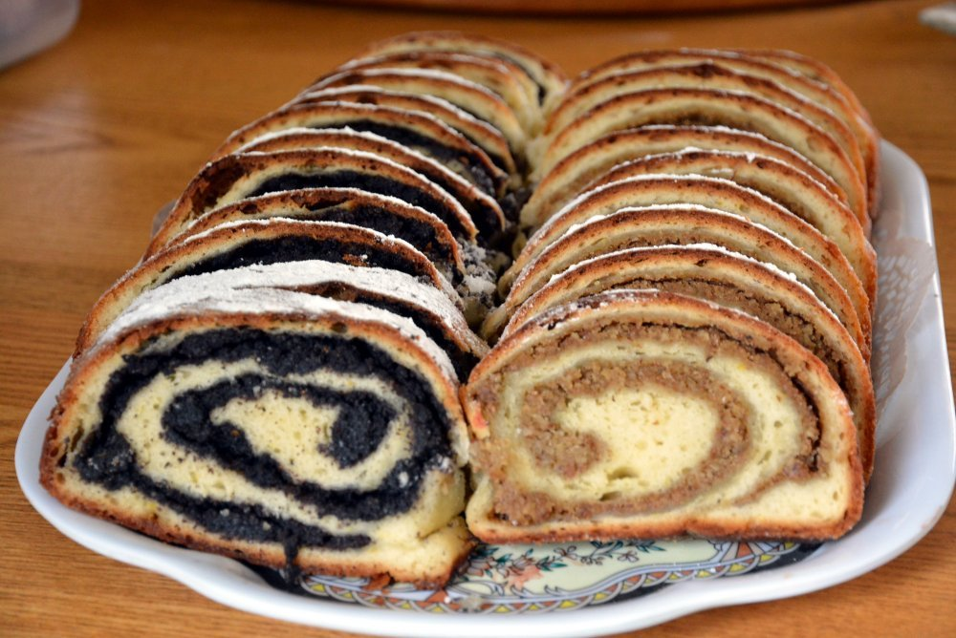
Cuisine
The continental cuisine
is heavily influenced by Hungarian, Austrian and Turkish culinary styles
meat, freshwater fish and vegetable dishes are

Slide 11
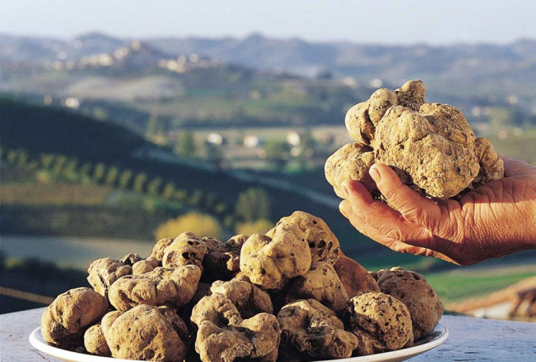
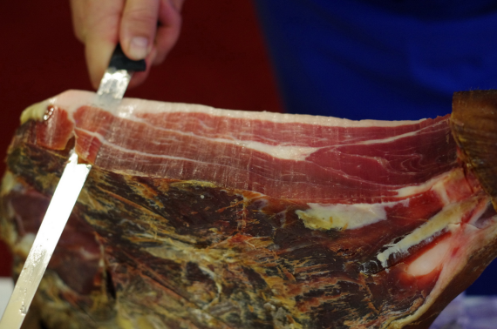
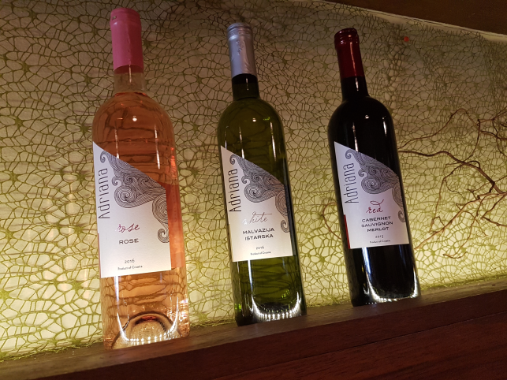
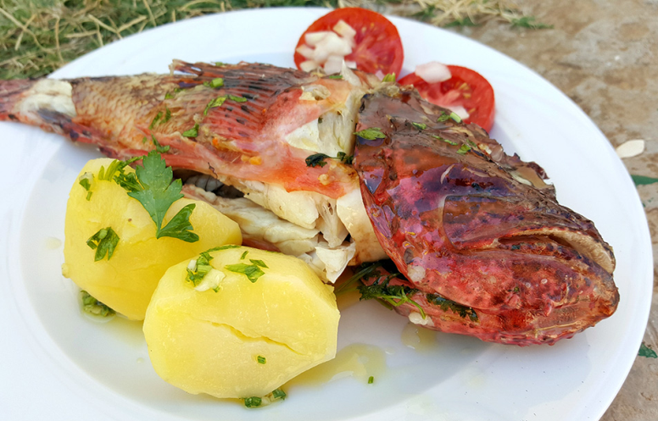
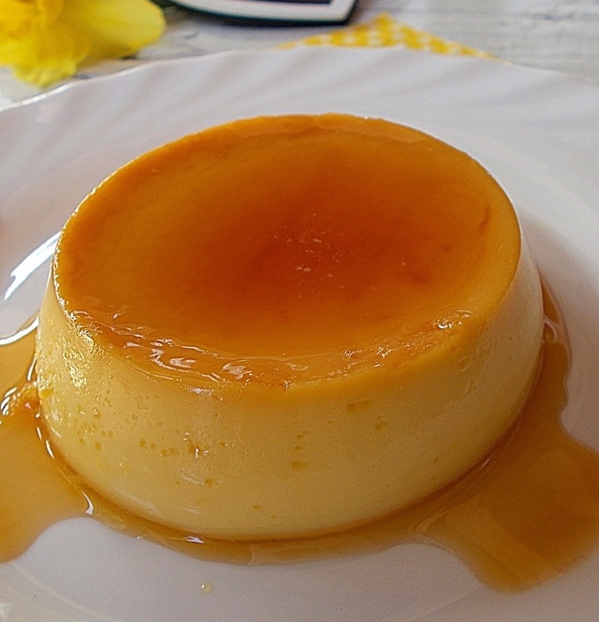
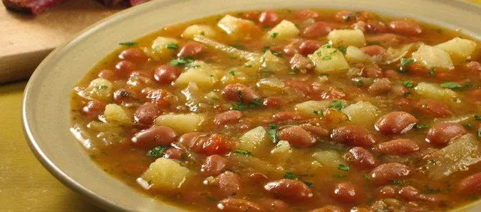
Cuisine
Dalmatian and Istrian cuisine
draw upon culinary influences of Italian and other Mediterranean cuisines
They prominently

Slide 12
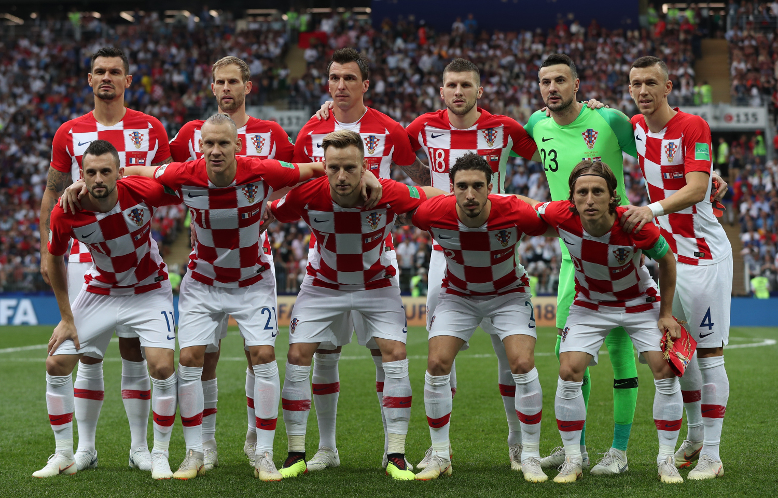
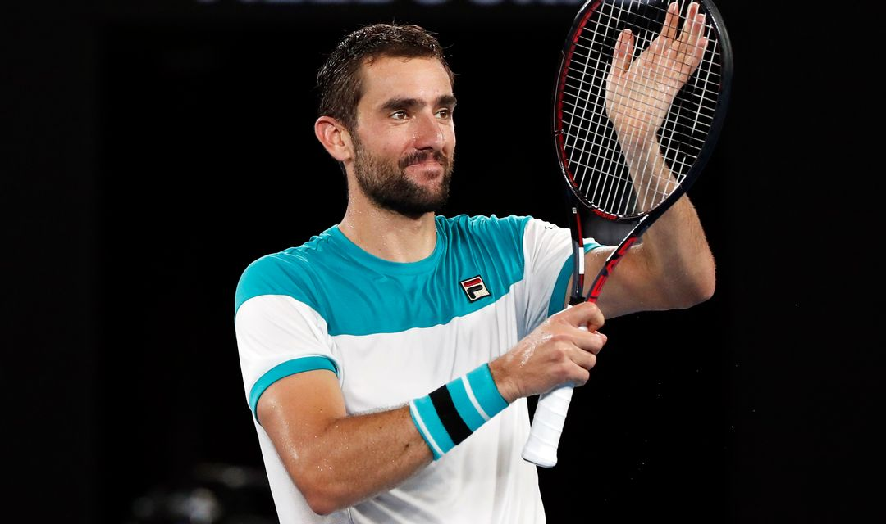
Sports
Croatians are passionate about soccer, and have a skilled national team
basketball, handball, tennis and waterpolo
Marin Čilić, tennis
Croatian football team

Slide 13
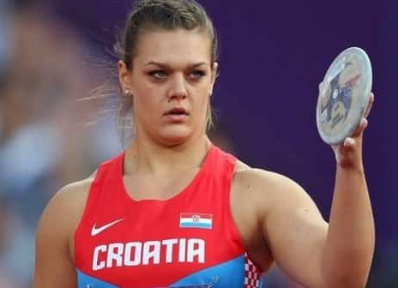
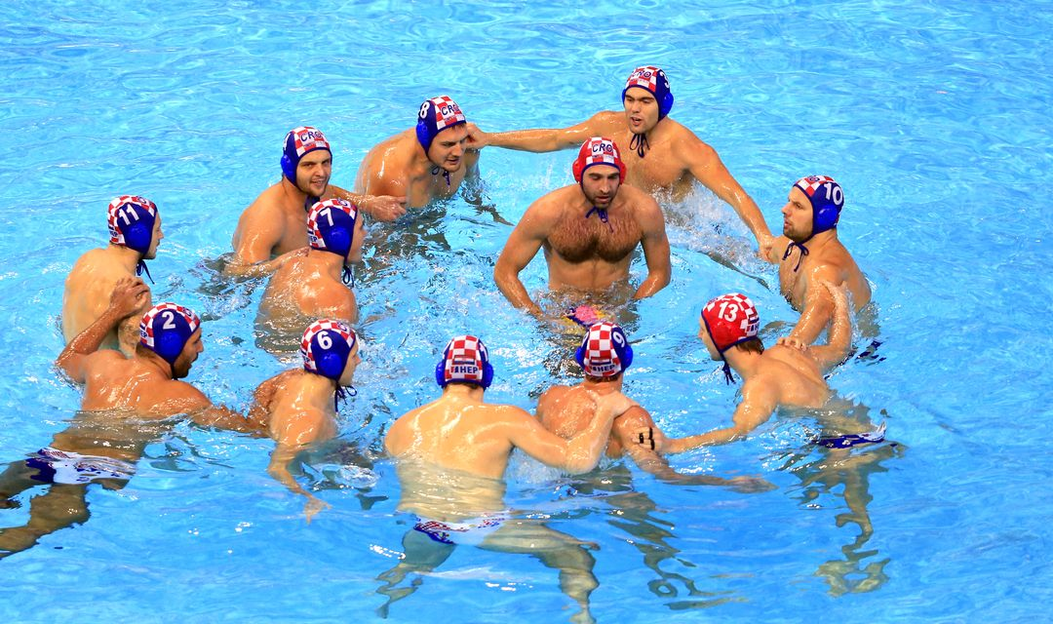
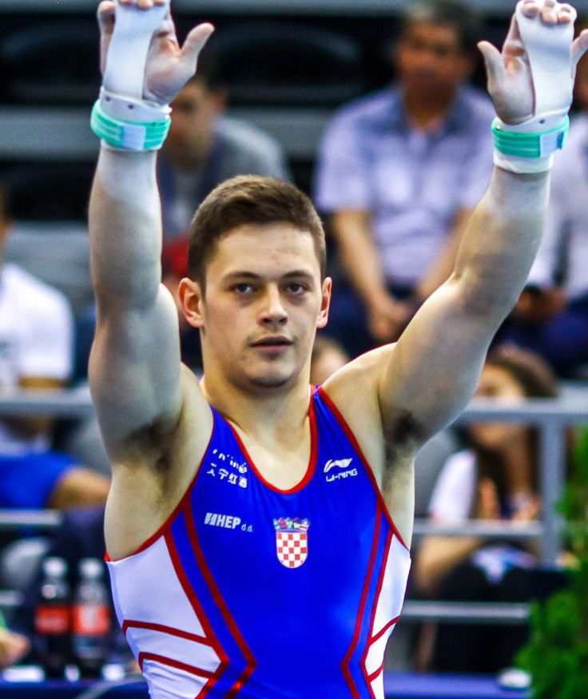
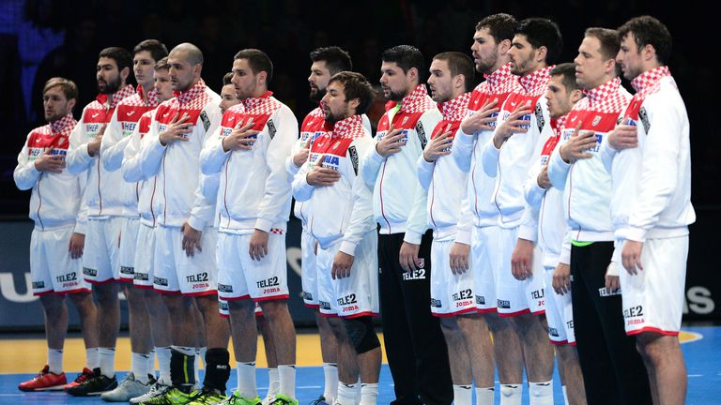
Sports
Sandra Perković,athlete
Croatian water polo team
Tin Srbić, gymnastics
(X.gymnasium Ivan Supek former student)
Croatian handball team
Blanka Vlašić, high jump

Slide 14
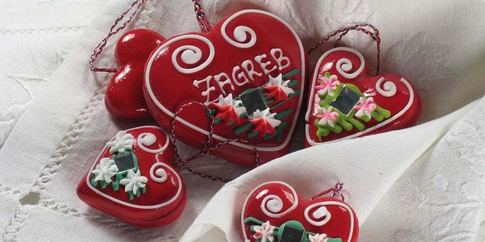
ZAGREB
The capital of Croatia

Slide 15
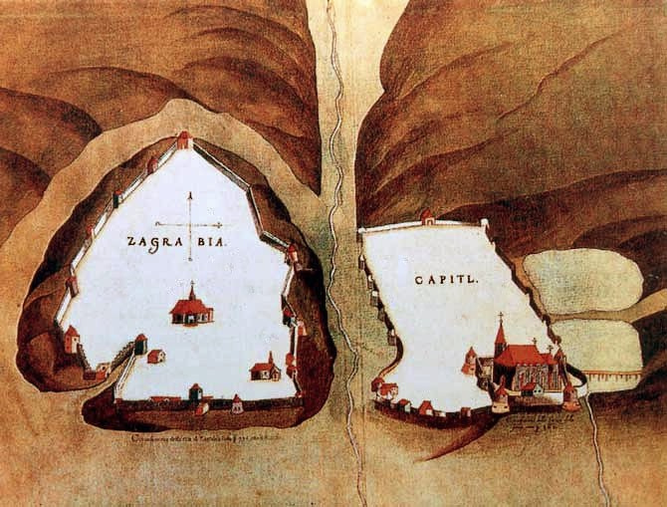
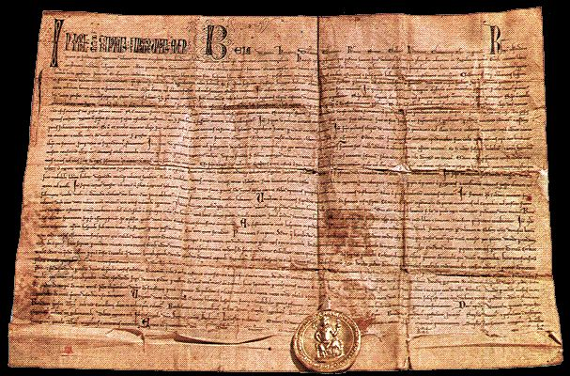
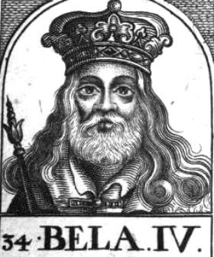
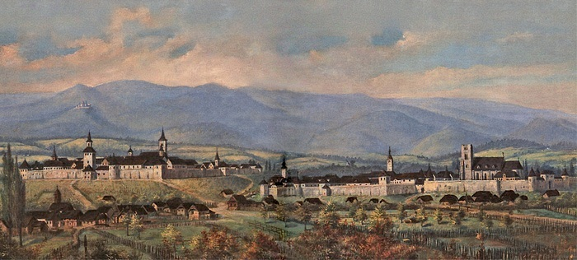
HISTORY
Zagreb is first mentioned as a Bisphoric in 1094.
King Bela IV (1206 – 1270) found refuge in Zagreb and managed to hide himself from the nomadic tribe
Gradec and Kaptol, divided by the Medvešćak river
The Golden Bull
Bela IV.

Slide 16
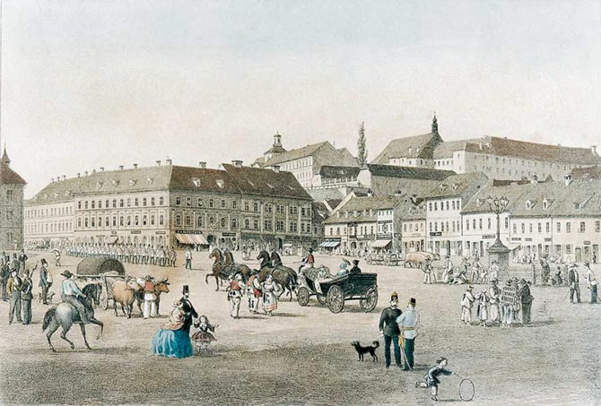
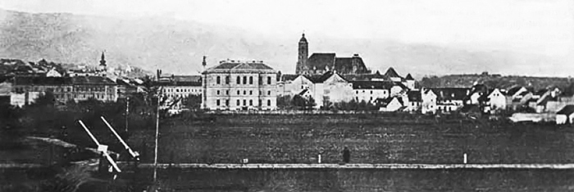
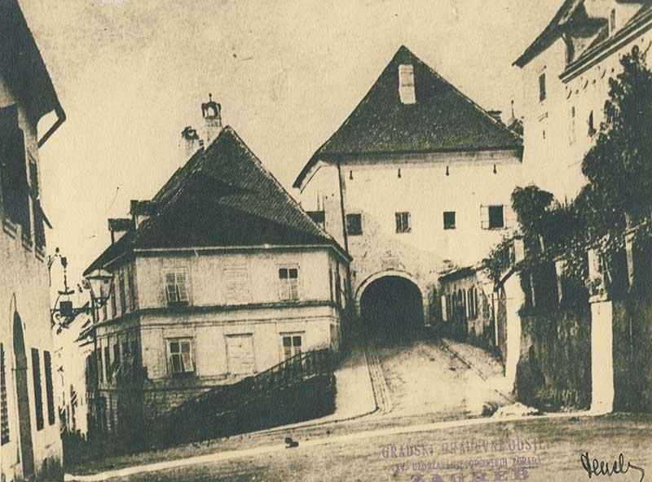
'
The creation of a unified town
By the King‘s proclamation on 7th September 1850., „The free royal borrough of Gradec, Kaptol, Nova Ves, Vlaška street, their suburbs and villages” were unified to form Zagreb
The new center of municipal life was in the Lower Town, from the Ban Jelačić Square in the north to the railway line in the south
Ban Jelačić square in the late 19th century
Kamenita gate leading to Gradec
Panoramic view of Zagreb in 1880.

Slide 17
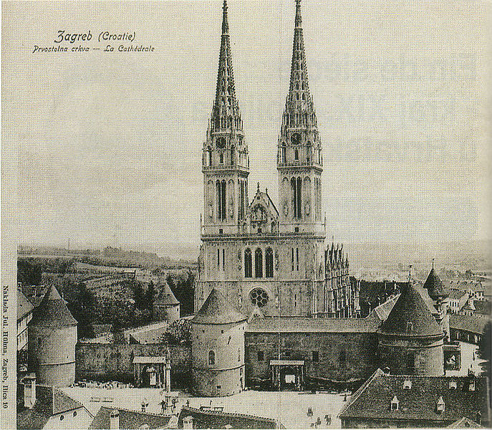
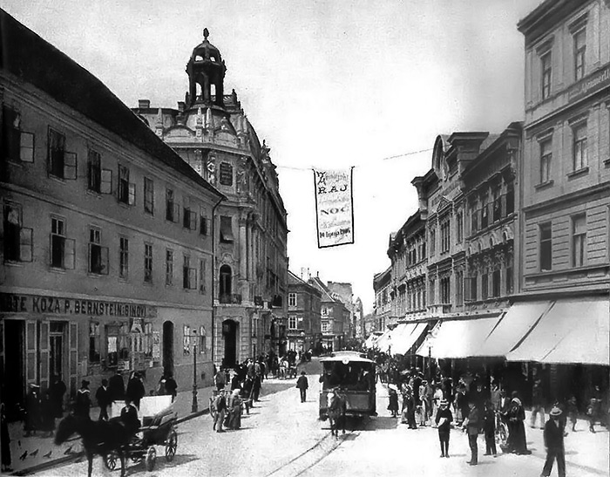
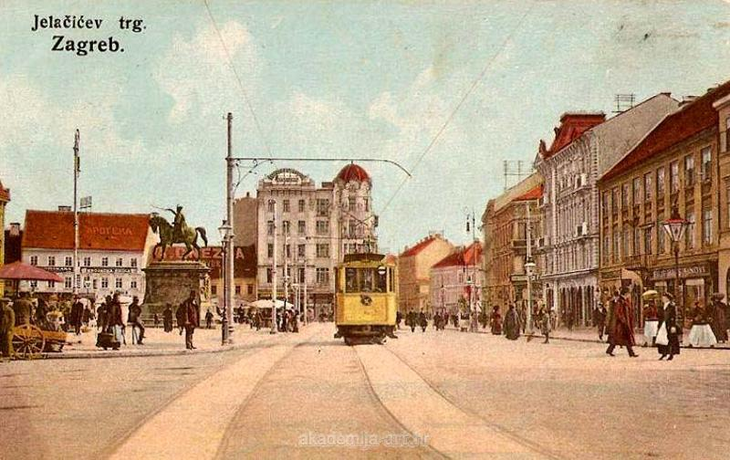
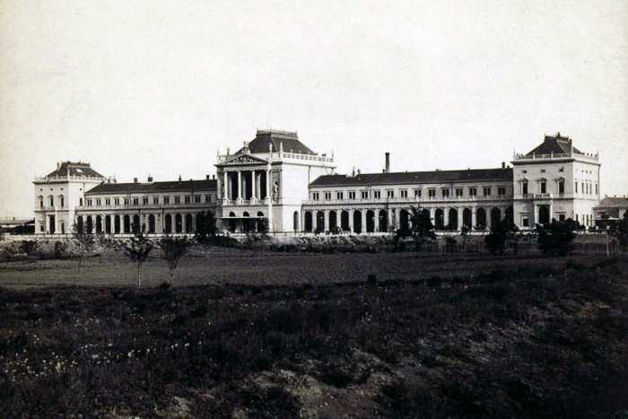
The rapid growth of Zagreb
After the 1880. earthquake, Zagreb experienced a rapid growth – many historic buildings were constructed, and Zagreb began to look like a city:
The new cathedral, finished in 1906.
Arrival of the tram – sign of a modern city of the 20th century
Ilica – Zagreb main street in the Lower Town
The Main railway station, finished in 1892.

Slide 18
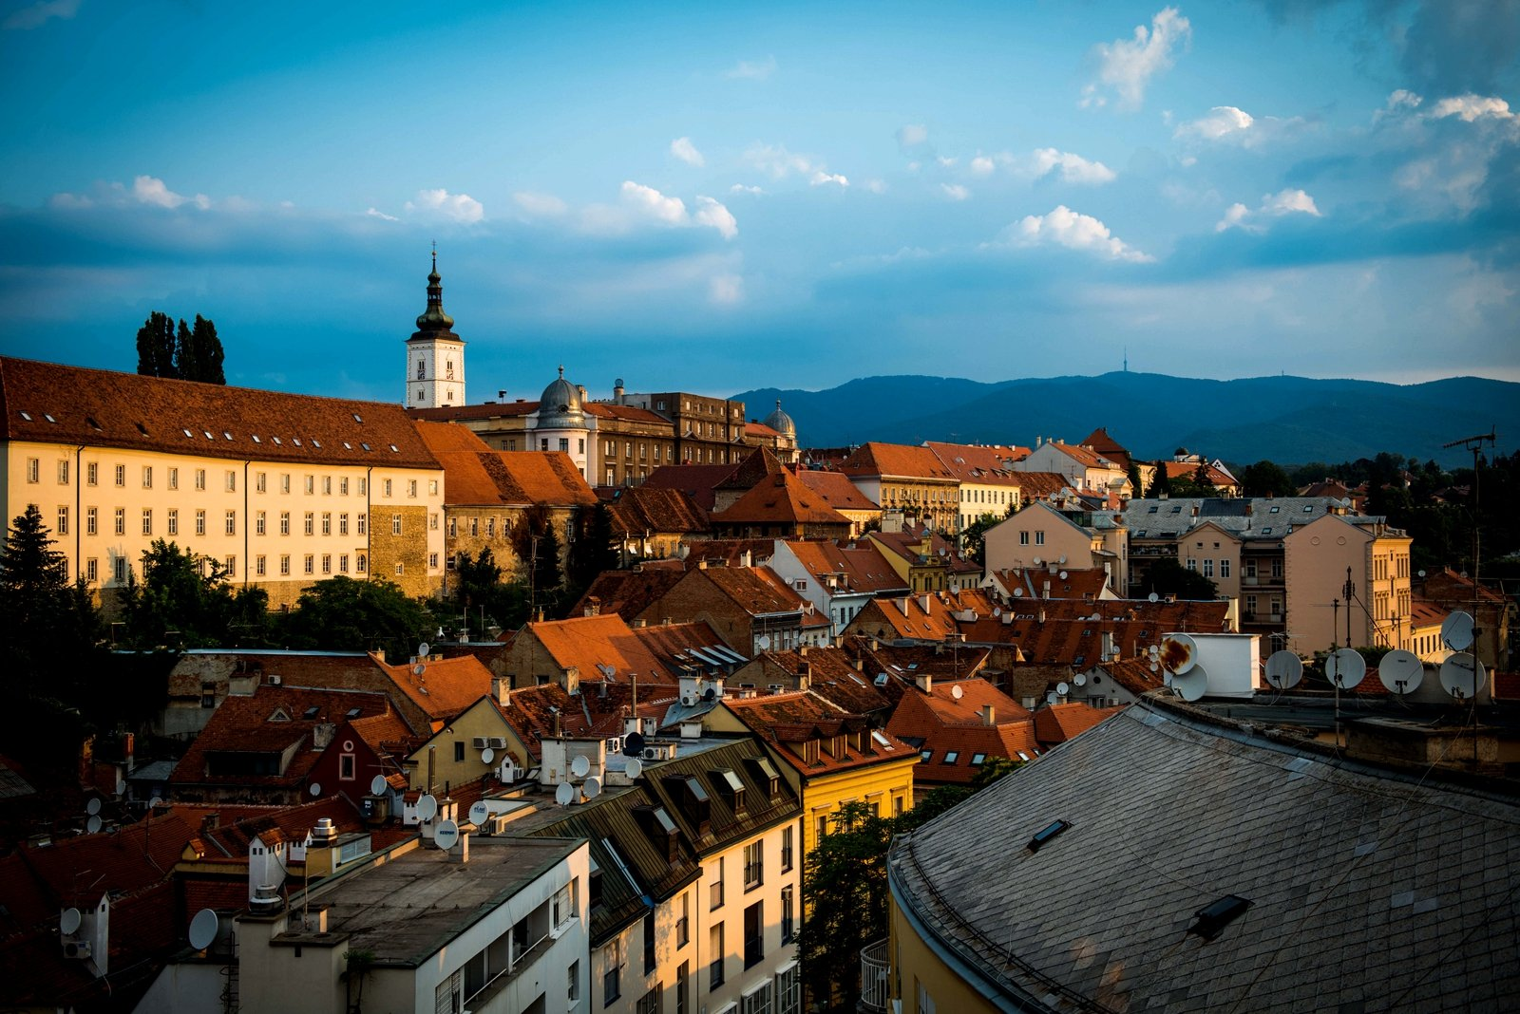
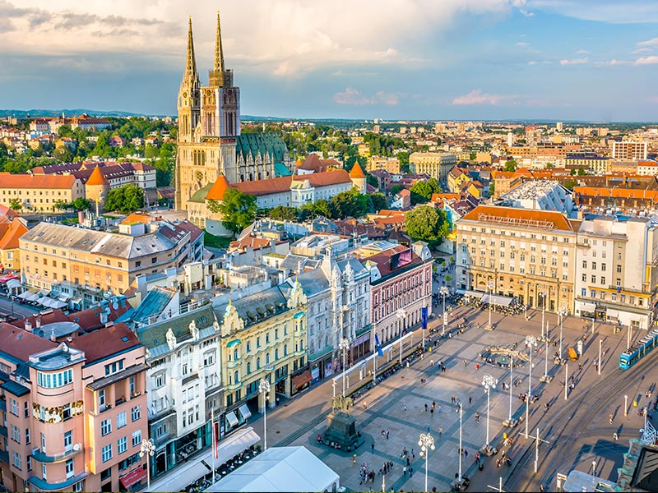
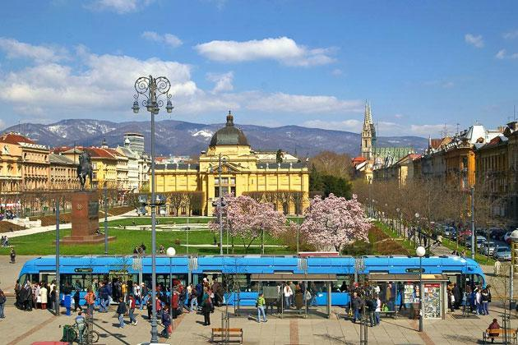
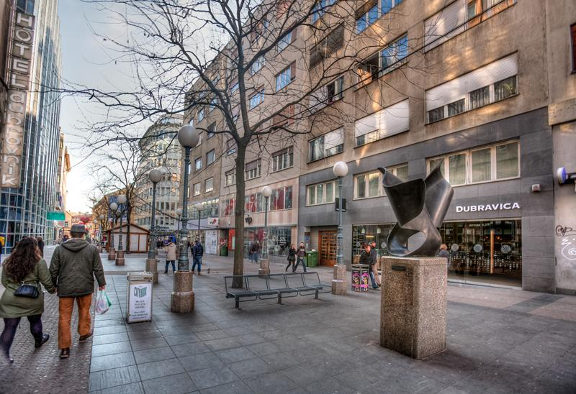
Cultural heritage
Zagreb has a unique urban plan consisting of its Upper and Lower Town and the Novi (New) Zagreb on the right bank of the river Sava on which Zagreb is situated
It is the home of many beautifull buildings and parks:
Upper and Lower Town
Ban Jelačić square
King Tomislav square

Slide 19
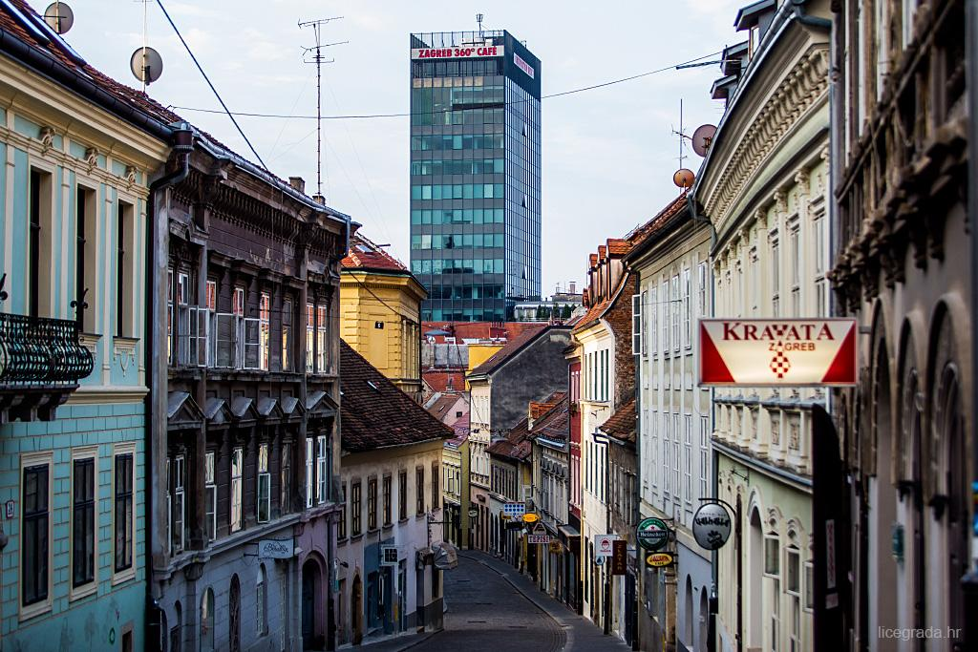
Radićeva street
St. Mark church
Zrinjevac park
Heritage tram and the Zagreb funicular
Grič tunnel under the Upper Town

Slide 20
Zagreb – Capital of culture
All main cultural institutions are based in Zagreb
They define Zagreb’s culture through theaters, art galleries, museums and festivals which are organised all year round
Modern arts museum
Croatian National Theatre in Zagreb
Croatian academy of science and arts

Slide 21
Music is very important to Zagreb – many concert halls and music festivals contribute to its culture:
Croatian Music Institution in Zagreb
Vatroslav Lisinski concert hall

Slide 22
Local culture
Local people play a big part in the cultural heritage of Zagreb:
Dolac market with the Šestinski umbrellas
Licitar hearts

Slide 23
Festivals
Zagreb is home to hundreds of festivals throughout the year – many of which combine music, art, food, street performing or the Christmas advent
The Christmas Advent in Zagreb
Performers on the Ban Jelačić square
Zagreb film festival

Slide 24
X. grammar school ”Ivan Supek”
Zagreb,Croatia

Slide 25
X. grammar school”Ivan Supek”
One of the largest high schools in Croatia
1 140 students
111 employees:
86 teachers
4 professional associates
(pedagogue, psychologist, 2 librarians)
18 nonteaching staff

Slide 26
Extra-curricular activities
School magazine ”Cener” group
Drama club
Debate club
Student choir
Readers group - Bookworms
Sorry, we just realized this will take too long :)

Slide 27
Social and cultural projects:
Ivan Supek days
European Language day
Erasmus+ projects
Christmas fair, carnival
Field trips and excursions

Slide 28
X. grammar school”Ivan Supek”
41 classes in total:
28 – general education
13 – mathematics and natural sciences
8 – bilingual programme

Slide 29
X. grammar school”Ivan Supek”
bilingual programme
Subjects taught in English: Maths, Physics, Chemistry, Biology, Geography, Sociology, Ethics, Computer science

Slide 30
Erasmus+ Integrated Literacy in Action

