Slide 1
My presentation about Easter
Predentation made by Anna Jakubowska

Slide 2
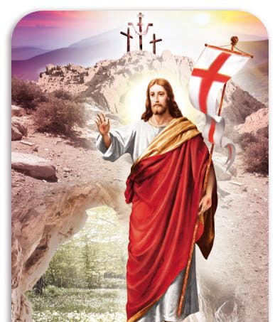
What Easter is?
Easter is one of the principal holidays of Christianity. It marks the Resurrection of Jesus three days after his death by crucifixion.
This year, Easter will be on March 31st, 2024.
Easter means "The season of growing sun" or " The season of new birth". The celebration originated from pagan holiday dediated the Goddness Ostara.

Slide 3
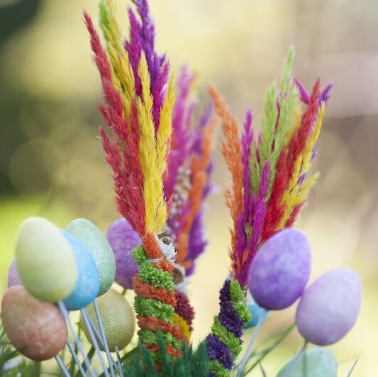
Palm sunday
Palm sunday was established to commemorate the ceremonial entry of Jesus into Jerusalem, when the inhabitants of the city welcomed Him by waving palm branches and shouting hallelujah.
According to tradition, on Palm Sunday, believers come to church with palm trees, which are a symbol of reborn life.

Slide 4
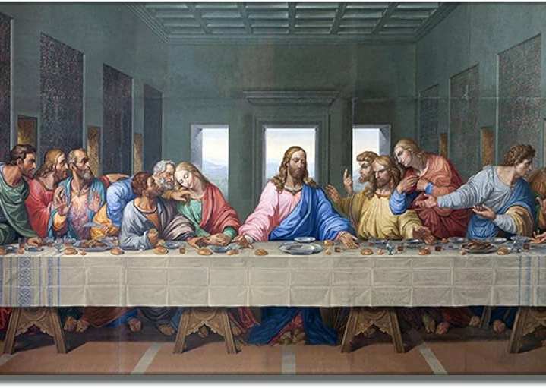
Maundy Thursday
Maundy Thursday in the Church's liturgy is a commemoration of the Last Supper and the institution of the Blessed Sacrament and the sacrament of priesthood.
In parish churches, only one solemn mass is celebrated in the evening - the Mass of the Lord's Supper, which begins the Paschal Triduum

Slide 5
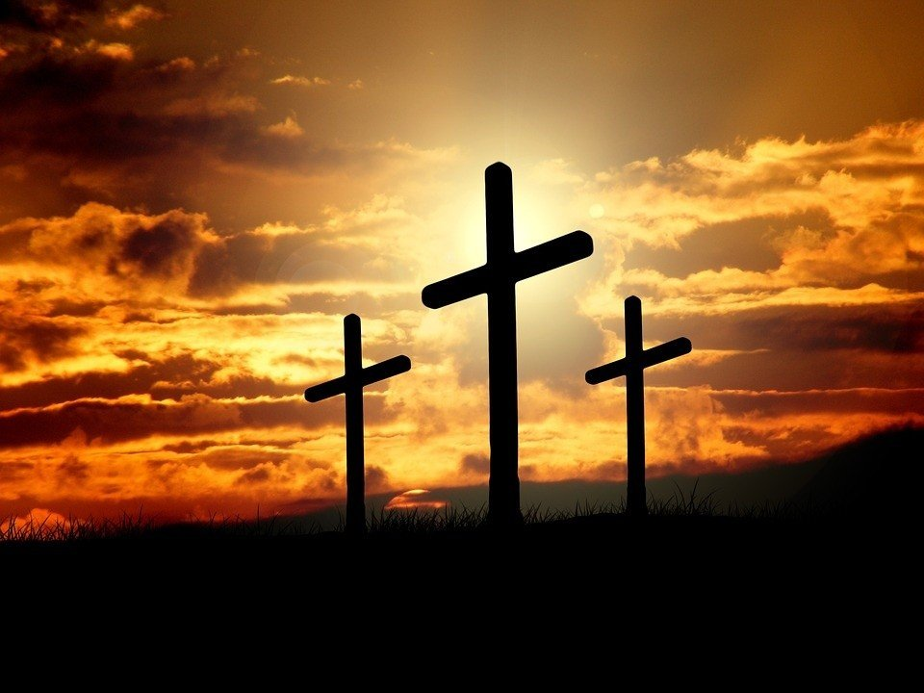
Good friday
The Good Friday liturgy in the Catholic Church is a commemoration of the suffering and death of Jesus Christ on the cross.
On this day, a strict fast is observed, and the faithful adore the cross in the church.

Slide 6
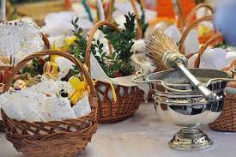
Holy Saturday
Holy Saturday is the day of Jesus' repose in the tomb and adoration of the Blessed Sacrament. It is celebrated as a day of blessing, because fire, water and Easter food are blessed then.

Slide 7
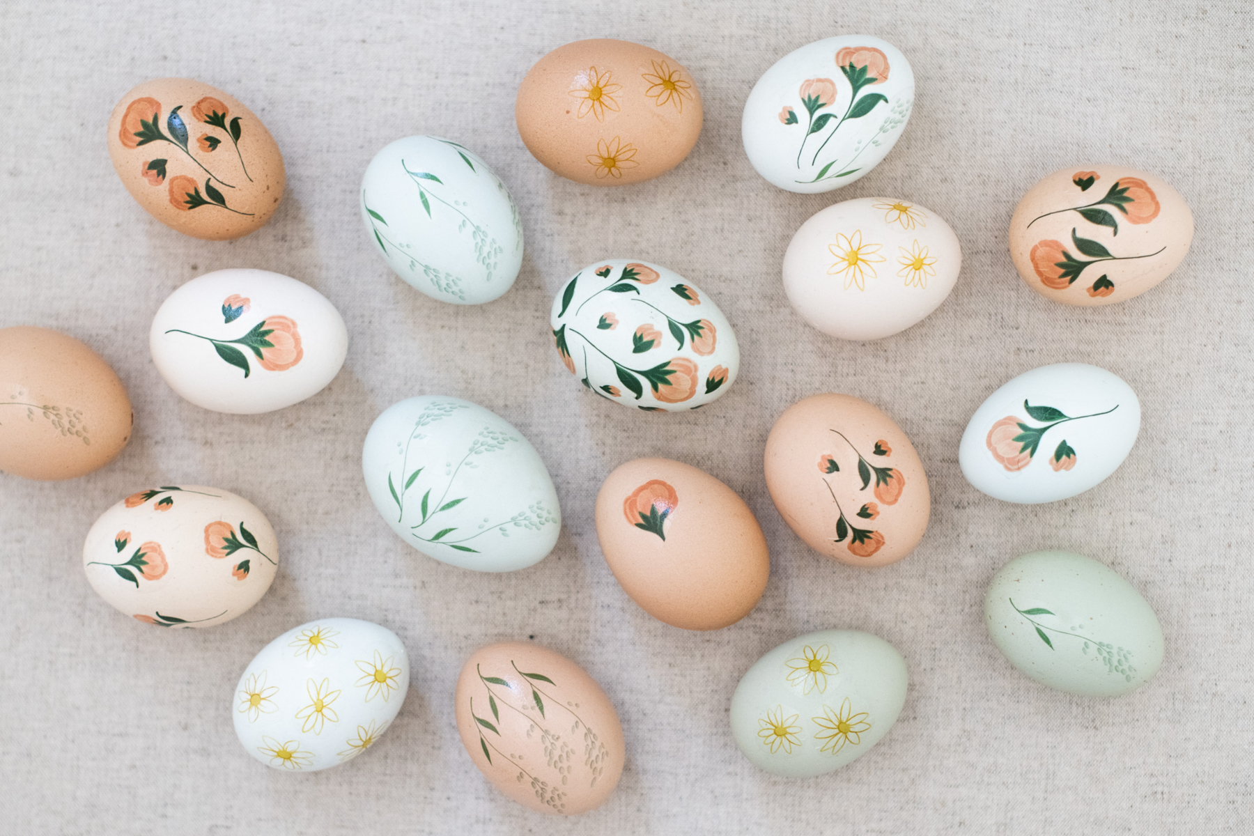
Easter customs
painting Easter eggs- children paint eggs and then put them in an Easter basket
Wet Monday- Children and adults they douse themselves with water. Its an Old Polish tradition.
Easter Bunny came to children with presents.
Sharing eggs with family.
At the easter breakfast consecrated food are eaten for example ham, eggs, bread etc.

