Slide 1
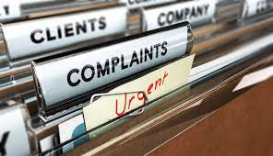
Complaints Reklamácie
Príloha č. 8
4.r BiOA

Slide 2
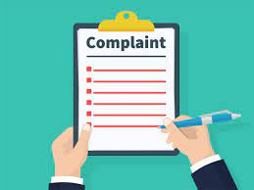
Complaint
a statement that something is wrong or not satisfactory

Slide 3
Letter of Complaint: Definition
A complaint letter is a letter written to concerned authorities if we are not satisfied with the service provided by them.
These letters are usually formal in nature.
Sometimes when we order a product and it is received defective then we write the letter to the related person or company,
complaining about the product

Slide 4
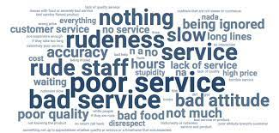
Reasons for complaint:
wrong goods received
poor service
unsatisfactory quality of goods
late delivery
damaged goods
prices not as agreed

Slide 5
Plan for drafting a letter of complaint:
1. Introduction
If possible, begin with a positive – e. g. you might refer to previous good service.
Describe the item or service you bought, or the incident that happened.
If appropriate, say where and when you bought the item (service) and how much it cost.
3. Action
You may form a conclusion here with your feelings about the situation.
State what you expect to be done rectify the situation, e. g. a refund or repair, or the job done again without charge. Alternatively, you may simply ask the recipient to investigate the matter and take the necessary action.
2. Details
Explain what is wrong, any action you have already taken, to whom you spoke and what happened.
This section must be structured logically.
4. Close
Close with a simple one-liner saying you hope to receive a prompt reply.

Slide 6
Useful Phrases & Language
Opening
Dear Sir or Madam, / To whom it may concern,
I am writing to express my disappointment with/dissatisfaction with the service I received in…
I would like to lodge a formal complaint against your company for the reasons outlined below:
I feel compelled to write to you in order to describe the

Slide 7
Useful Phrases & Language
Listing problems
First of all,
Not only was there a hair in my wife’s soup, but the main course also arrived cold.
On top of that…
As if that was not enough…
To top it all off…
My first complaint is
The first problem is
The first thing I would like to draw your attention to is
My first concern is
The straw that broke the camel’s back was…

Slide 8
Useful Phrases & Language
Complaining expressions
The standard of the… was not up to scratch.
The… was not up to the expected standard.
The… left a lot to be desired.
The… failed to live up to our expectations.
We were left bitterly disappointed by…
The quality of the customer service we received was woefully inadequate.
The… was an absolute disgrace. (v.strong)
Overall, our visit to your (restaurant) was an unmitigated disaster from start to finish.

Slide 9
Useful Phrases & Language
Requesting action
It seems only fair that you should… (offer a full refund)
I would appreciate it if you…
I would be grateful if you…
I suggest that you replace the item
I therefore suggest that I be given a full refund
I would be grateful if my money was refunded
I would be grateful if you could give me a full refund
Should these demands not be met, you will be hearing from my lawyers.
I expect to receive compensation to the tune of (€2000) for the…

Slide 10
Useful Phrases & Language
making recommendations
I strongly recommend that your organisation…
It would be advisable to…
I suggest re-evaluating your procedures regarding…

Slide 11
Useful Phrases & Language
sign off
I look forward to receiving your reply.
I look forward to hearing from you
I look forward to receiving a full refund
I look forward to receiving a replacement
I look forward to receiving your explanation
I expect to receive a prompt reply to this letter.
Yours faithfully,

Slide 12
Remember:
not to be offensive or disrespectful
even when complaining, there should be no reason ever to be abusive or impolite
assertiveness without aggression is always the way to go
keep copies of your letters or emails, and never send original documents or receipts
to ACE your subject lines when writing a letter of complaint:
Appropriate. Use suitable details that are meaningful and relevant.
Concise. Keep it as brief as possible, while giving all the necessary details.
Exact. Make sure all the information is accurate and complete.

Slide 13
TASK 1: put the sentence into correct order according to parts of the letter:
Parts of the letter:
greeting
introducing your reason for writing
background information
what went wrong
what you´d like to happen
closing
Sentences:
Yours faithfully
I am writing to express my dissatisfaction at the service I received.
I would like a refund of the difference as soon as possible.
I have been a regular customer of your shop for many years.
Dear Sir/Madam
After leaving your shop today, I realized I had been charged £ 100 instead of £10.

Slide 14
TASK 2: put the sentence into correct groups:
k
A
What went wrong:
When I checked the item, I found that it had been damaged.
I hopw you can take steps to make sure this does not happen again.
I trust that you will replace the item.
The delay was unacceptable.
I would be grateful if you could look into the matter.
There seems to be a problem with
B
What you´d like to happen

Slide 15
Task 3: Rewrite these sentences using the passive to avoid saying 'the pharmacist.'
1. The pharmacist served me within ten minutes. I __________ within ten minutes.
2. I realised the pharmacist had given me the wrong medicine. I realised I ________the wrong medicine.
3. The pharmacist should have checked the prescription more carefully. The prescription should ______________more carefully.
4. The pharmacist corrected the mistake. The mistake _________________________ .
5. The pharmacist must not make this mistake again. This mistake must _________again.

